Slide 1
Chapter 3 - (Reliable) Broadcast
Introduction to Principles of Distributed Systems

Slide 2
problems for chapter test
Best-effort Broadcast — specification AND algorithm
Reliable Broadcast — specification AND algorithms (includes Lazy Reliable Broadcast and Eager Reliable Broadcast)
What is Uniform Agreement?
What is Probabilistic Validity?
FIFO Reliable Broadcast — specification AND algorithm
What are the three relations that determine if one message has caused another?
What is the Causal Delivery property?
What is the difference between Byzantine Consistent Broadcast and Byzantine Reliable Broadcast?
Exercises: 3.1?; 3.2; 3.3 (1-3); 3.4; 3.5; 3.6?; 3.7?; 3.8??; 3.10; 3.11; 3.14; 3.15;
Notes:
will need to have memorized 6 different algorithms for the problems given

Slide 3
SUPER important paper!!
(A Modular Approach to) Fault-tolerant Broadcasts and Related Problems. V. Hadzilacos and S. Toueg, Distributed Systems, 97-145, 1993.
We will look at some algorithms from this paper (but mostly from the book)

Slide 4
Setting
Distributed Systems use message-passing as the means of coordination
All links are point-to-point links
We want a communication abstraction that allows us to send a single message to all processes
this abstraction should provide guarantees
crashes affect outcomes and guarantees

Slide 5
from the simple…
Start by considering a client-server like architecture
Point-to-point links are just perfect for this
In practice, TCP gives us many guarantees
guaranteed delivery (assuming no partitions)
order guarantees
flow control
congestion control
Is this enough for a distributed system?

Slide 6
to the complex…
We want communication for more than just 2 processes
If processes in a system need to coordinate, they need to communicate
We thus will define broadcast primitives that provide different guarantees under different models
Broadcast abstractions allow a process to send a message, in a one-shot operation, to all processes in a system (to the group)
make sure that the processes agree on the messages they deliver

Slide 7
the issues of broadcast
Could just naively require that no message sent to the group be lost or duplicated
i.e., the processes agree to deliver every message broadcast to them
Defining “agreement” for broadcast primitives is not so easy
problems that don’t exist in point-to-point links
e.g., a sender fails by crashing in the middle of sending a message to all processes
some may deliver the message, some may not causing inconsistent views of the system
even harder for arbitrary-faulty behavior

Slide 8
guarantees in crash-stop model
Different abstractions give different guarantees
From “best-effort”
only ensures delivery among all correct processes if the sender does not fail
To “reliable”
best effort + ensures all-or-nothing delivery semantics, even if the sender fails
Then there’s total order (not in this chapter)
furthermore ensures that the delivery of messages follow the same global order
And finally, terminating (not in this chapter)
ensures that the processes either deliver a message or are eventually aware that they should never deliver the message

Slide 9
best-effort broadcast
The burden of ensuring reliability placed solely on the sender of a message
If a process receives a message, great, if not…
If the sender does NOT fail, then we get decent guarantees
NO guarantees provided if the sender fails
Note that broadcast messages are implicitly addressed to all processes
Note that all messages are unique

Slide 10
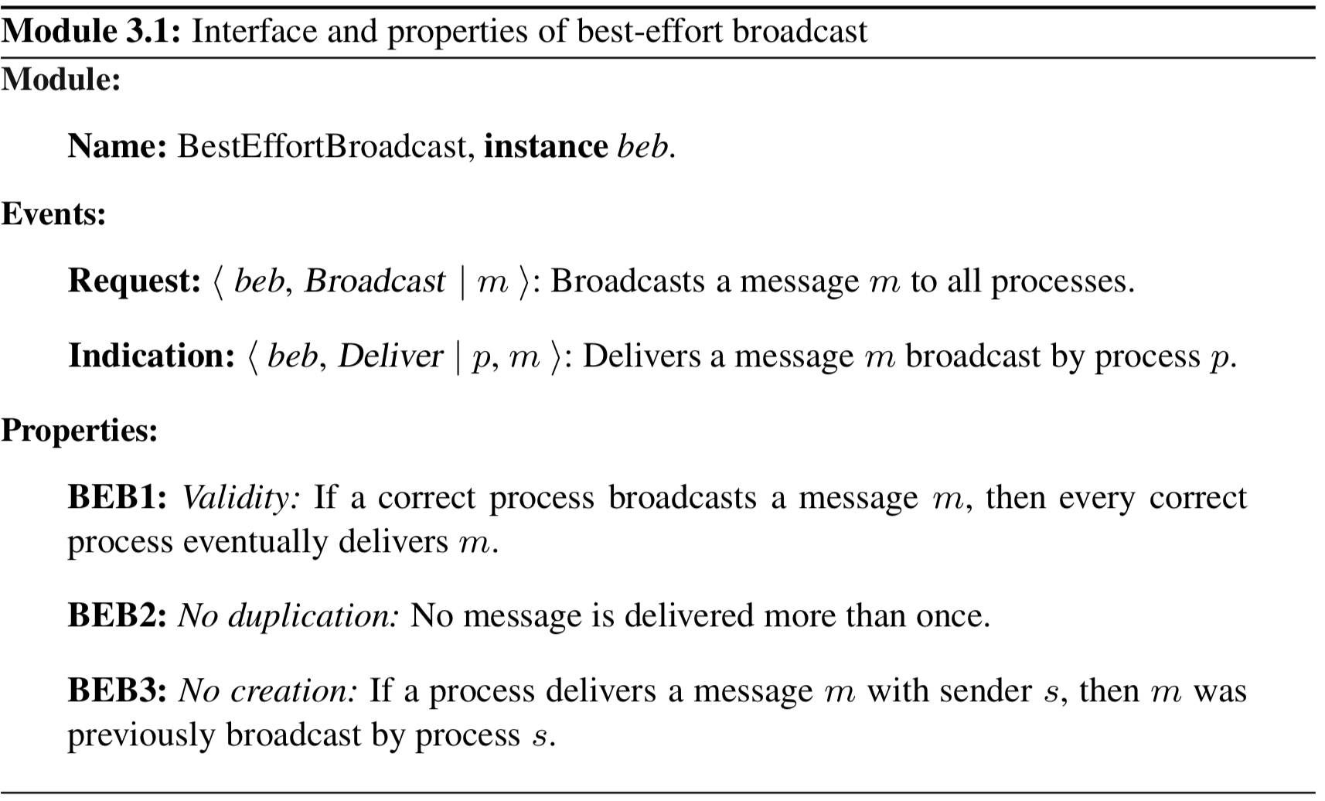
best-effort broadcast

Slide 11
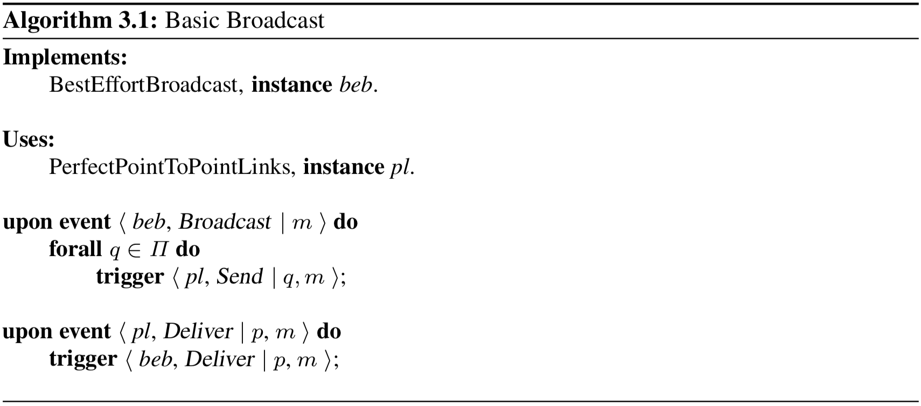
best-effort broadcast (fail-silent algorithm)
Notes:
BEB1: Validity: If a correct process broadcasts a message m, then every correct process eventually delivers m.
derived from the reliable delivery property of perfect links and the fact that the sender sends the message to every other process in the system
BEB2: No duplication: No message is delivered more than once.
BEB3: No creation: If a process delivers a message m with sender s, then m was previously broadcast by process s.
Performance: the algorithm requires a single communication step and exchanges O(N) messages

Slide 12
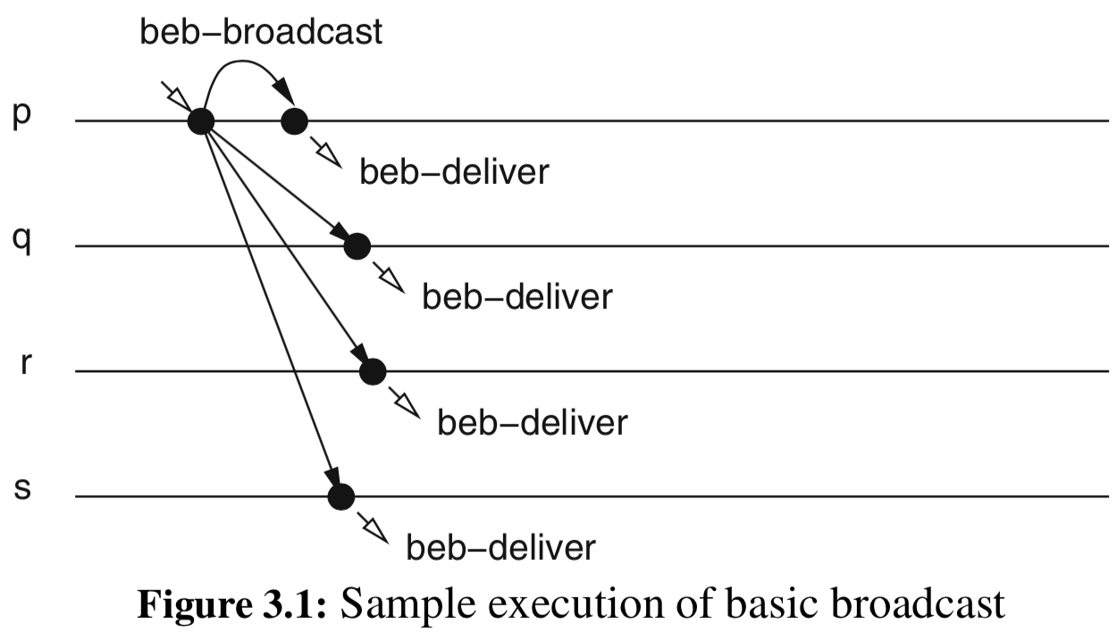
best-effort broadcast example

Slide 13
reliable broadcast
In Best-effort broadcast, if sender fails then agreement on the delivery of the message is unlikely
definite problem in many systems
Want a broadcast abstraction that assures agreement, even if sender can fail
(regular) reliable broadcast
Ensures that the correct processes agree on the set of messages they deliver, even when the senders of these messages crash during the transmission

Slide 14
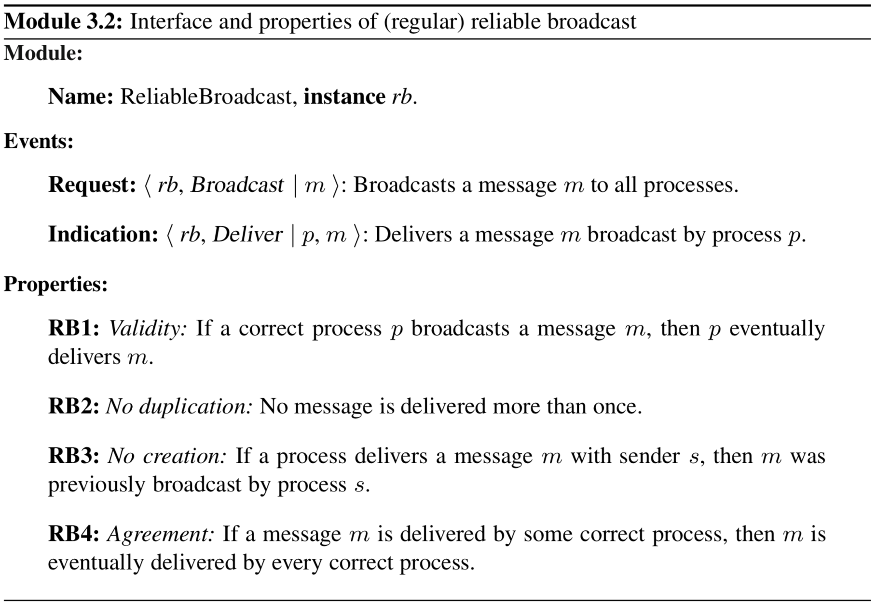
reliable broadcast
Notes:
Which ones liveness? validity and agreement
Which ones safety? the rest

Slide 15
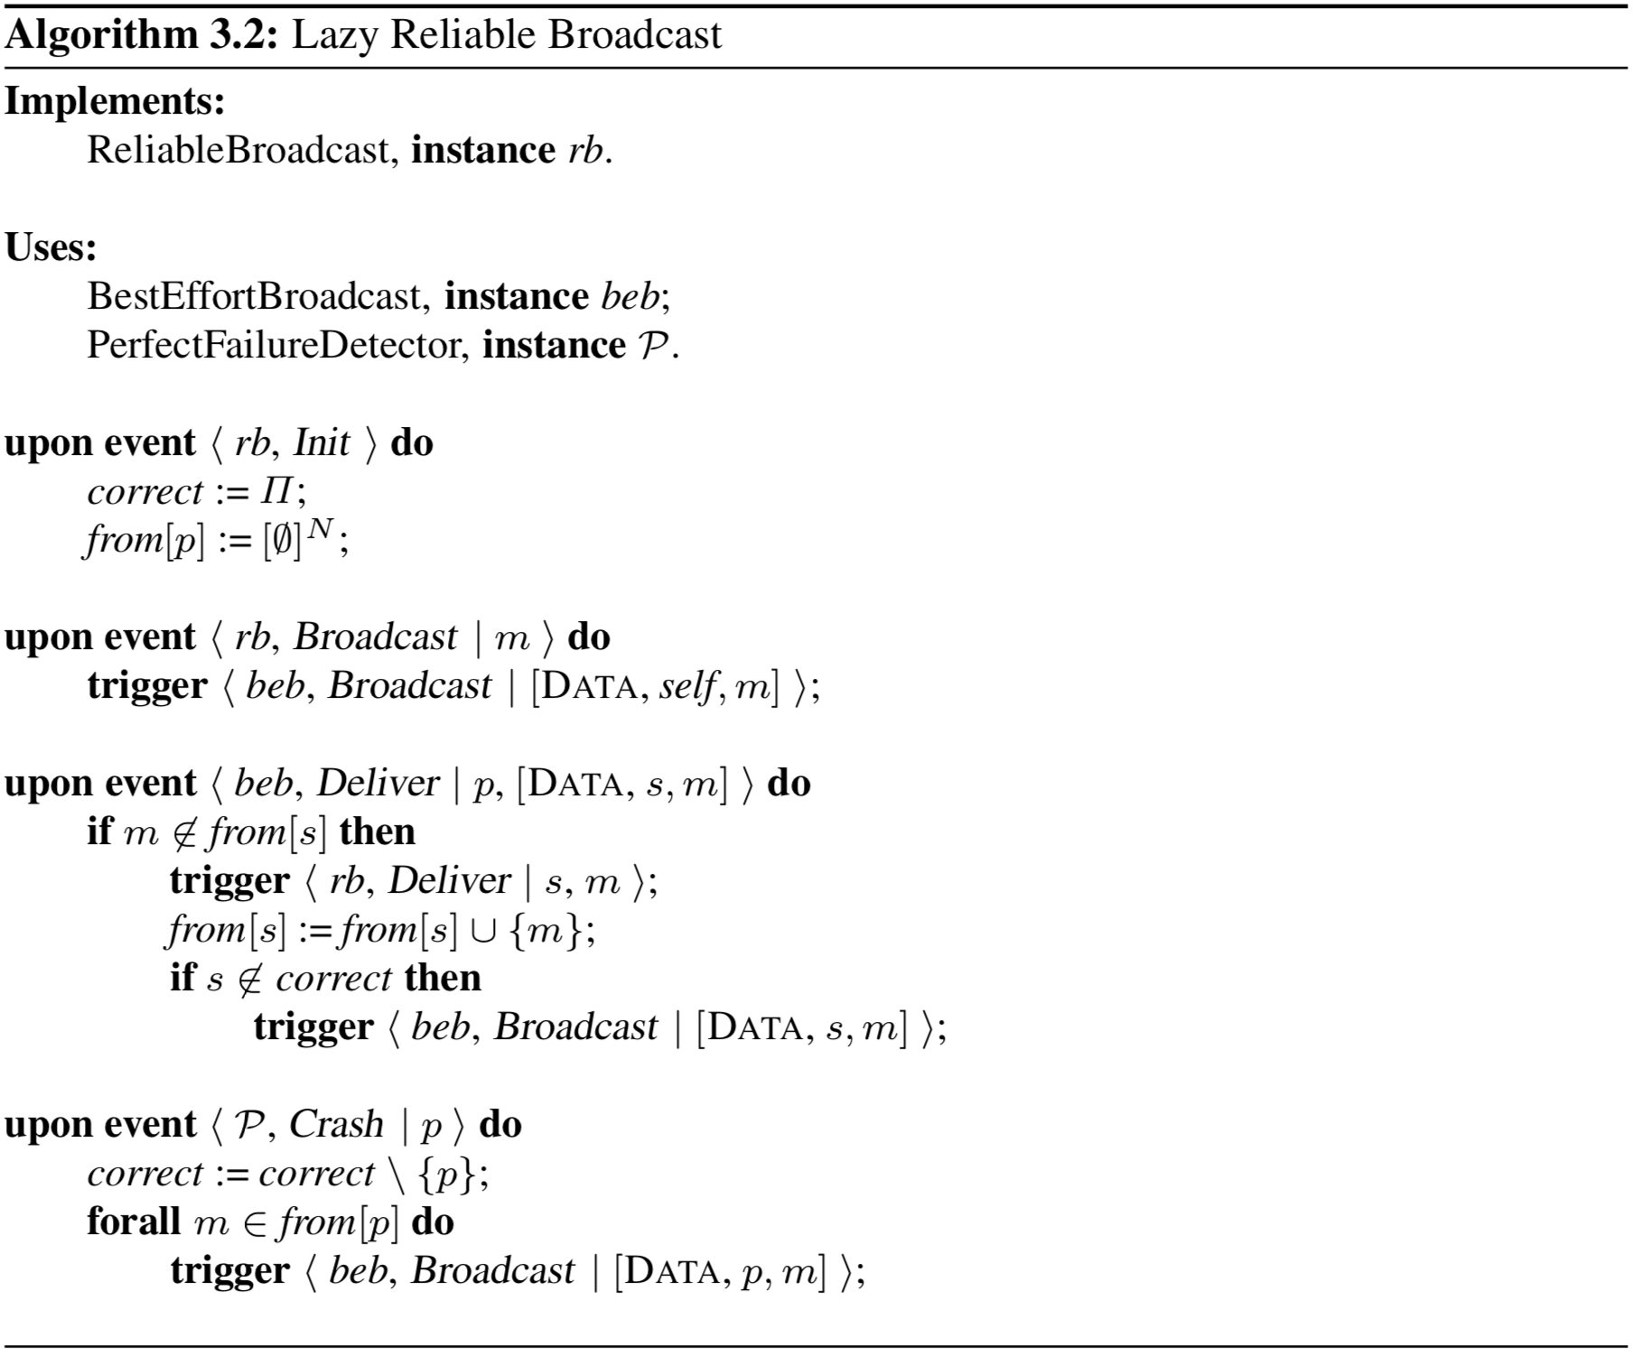
Notes:
For Fail-stop model
RB1: Validity: If a correct process p broadcasts a message m, then p eventually delivers m.
from validity of beb
RB2: No duplication: No message is delivered more than once.
RB3: No creation: If a process delivers a message m with sender s, then m was
previously broadcast by process s.
from no creation of beb
RB4: Agreement: If a message m is delivered by some correct process, then m is eventually delivered by every correct process.
from validity of beb
Performance: If sender does not fail, single communication step and O(N) messages
In worst case: O(N) steps and O(N²) messages

Slide 16
reliable broadcast
Want implementation that doesn’t HAVE to rely on perfect Failure detector
if the underlying failure detector completeness property violated, could violate agreement of broadcast
What could we do?
Could be pessimistic…
just “eagerly” rebroadcast EVERY message received
Thus assumes a fail-silent model

Slide 17
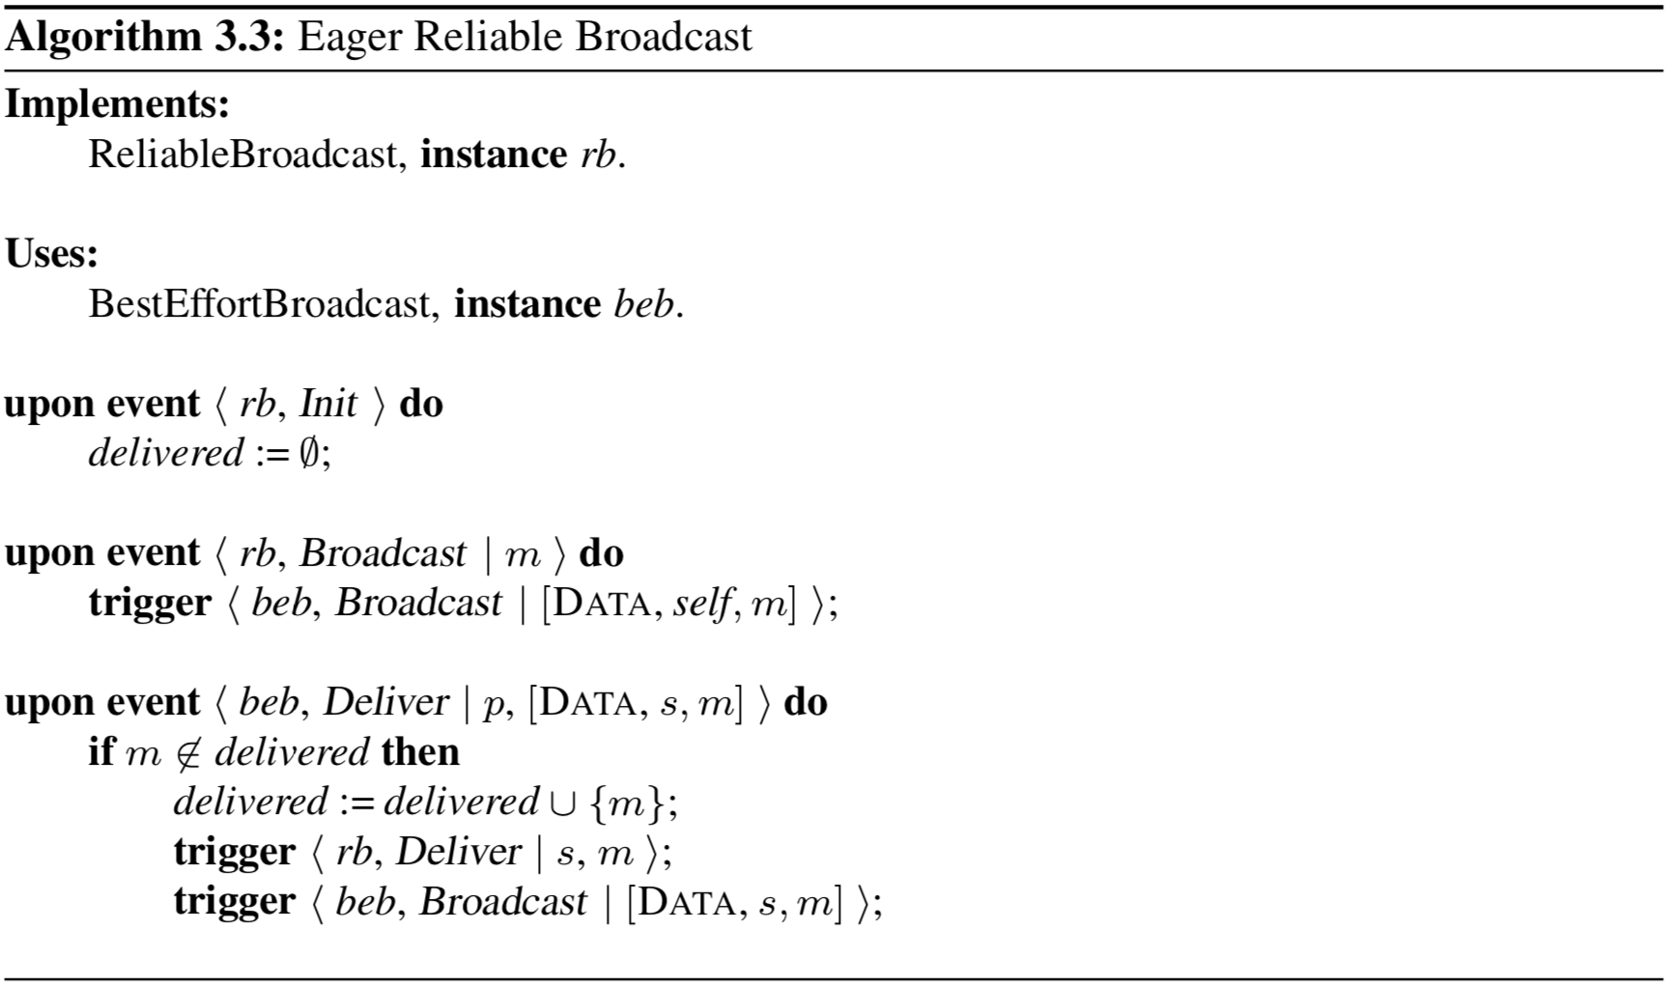
reliable broadcast
Notes:
Below, arguments same as in lazy-reliable broadcast
RB1: Validity: If a correct process p broadcasts a message m, then p eventually delivers m.
RB2: No duplication: No message is delivered more than once.
RB3: No creation: If a process delivers a message m with sender s, then m was
previously broadcast by process s.
RB4: Agreement: If a message m is delivered by some correct process, then m is eventually delivered by every correct process.
from the validity property of beb
Performance: Best case: single communication step and O(N2) messages
Worst case: O(N) steps and O(N²) messages

Slide 18
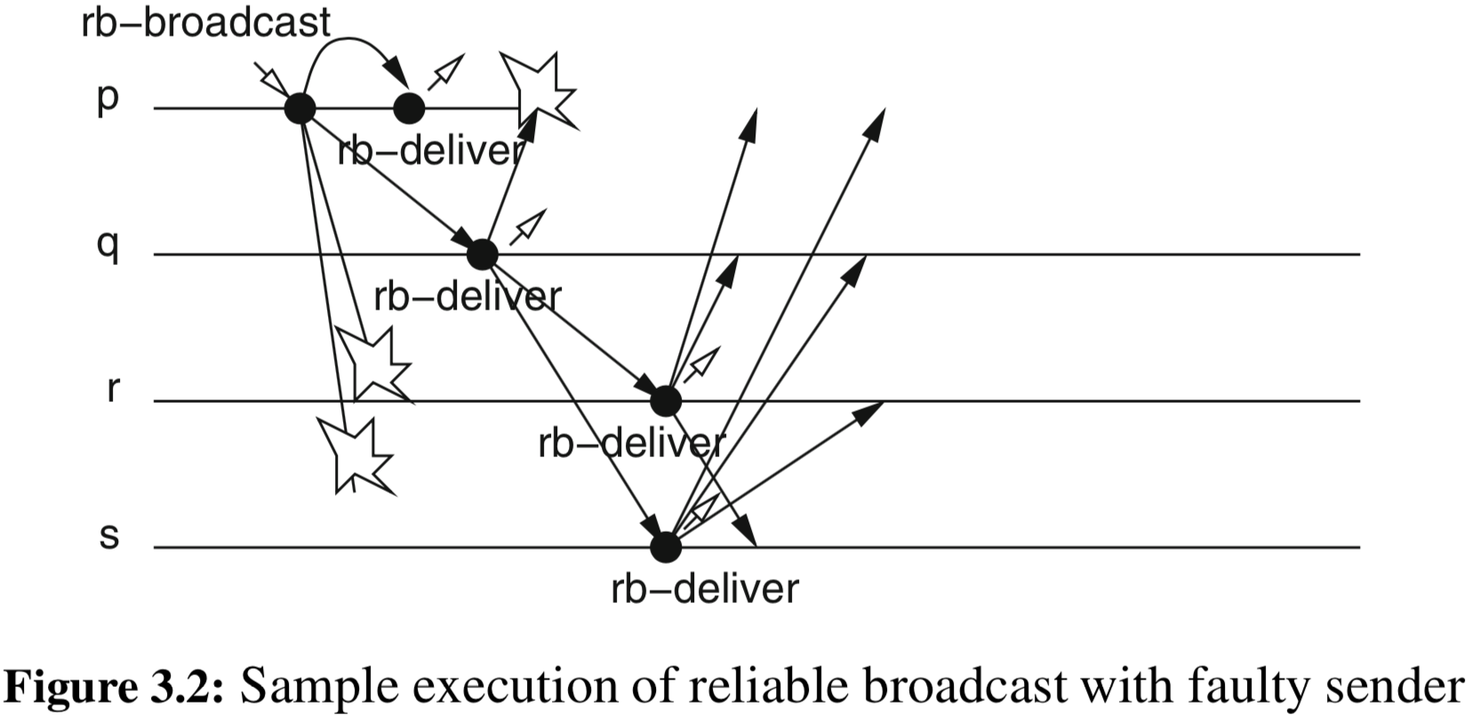
example

Slide 19
uniform reliable broadcast
Previous Reliable Broadcast just require the correct processes to deliver the same set of messages
doesn’t care what faulty processes deliver…
Scenario:
Process p rb-broadcasts message m
Process q receives message m
Process p crashes before sending anymore messages
Process q rb-delivers m but crashes before able to relay m
Causes inconsistent view among processes
Want to guarantee that the set of messages delivered by faulty processes is always a subset of the messages delivered by correct processes

Slide 20
is “uniformity” important?
Consider applications that interact with the outside world
printing on a screen
money authorization at ATM
triggering rocket launch
If ANY of these processes fail, still don’t want an inconsistent view
the fact that ANY process delivers a message is important, even if it crashes afterwards

Slide 21
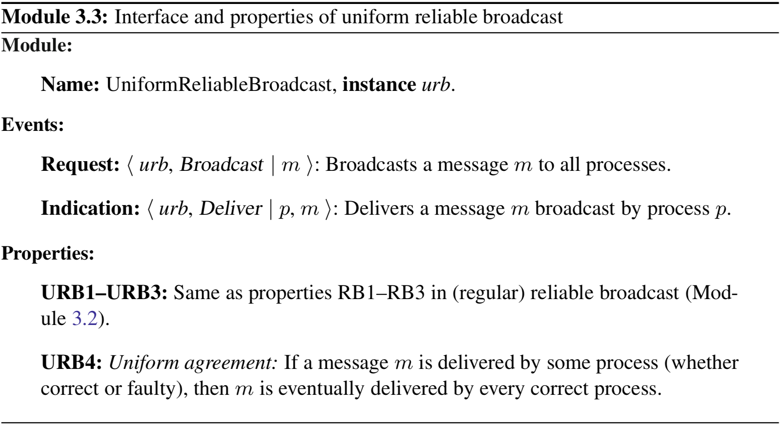
uniform reliable broadcast

Slide 22
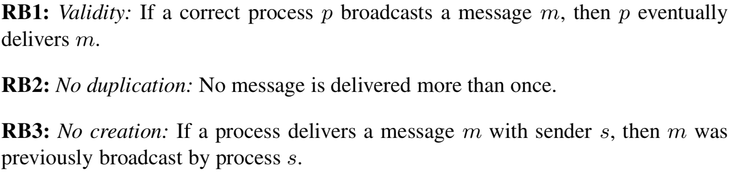
uniform reliable broadcast

Slide 23
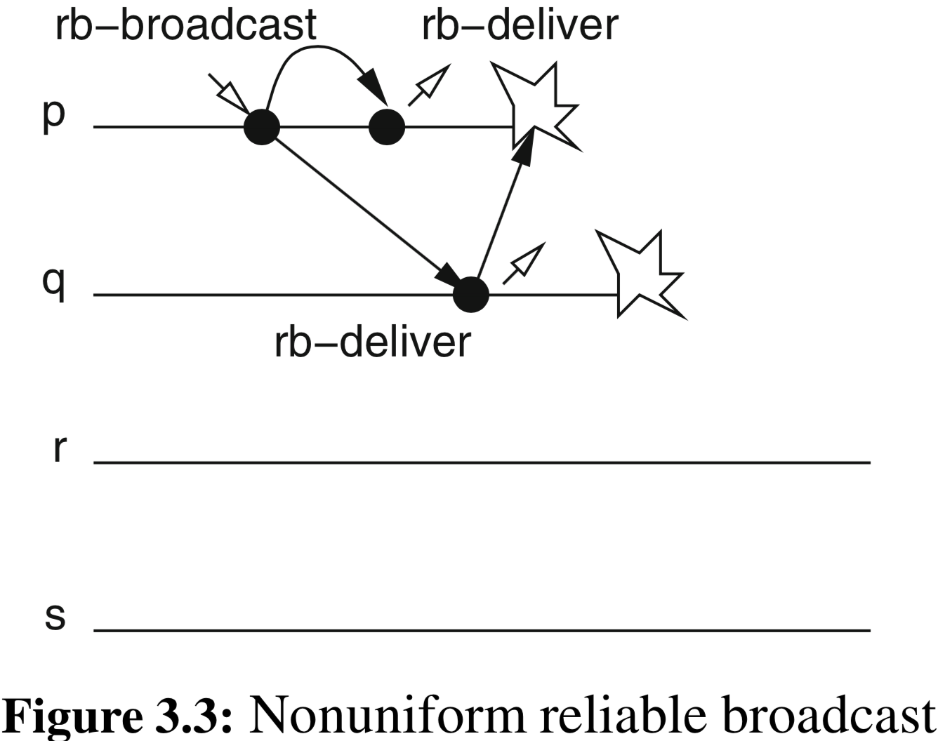
not uniform

Slide 24
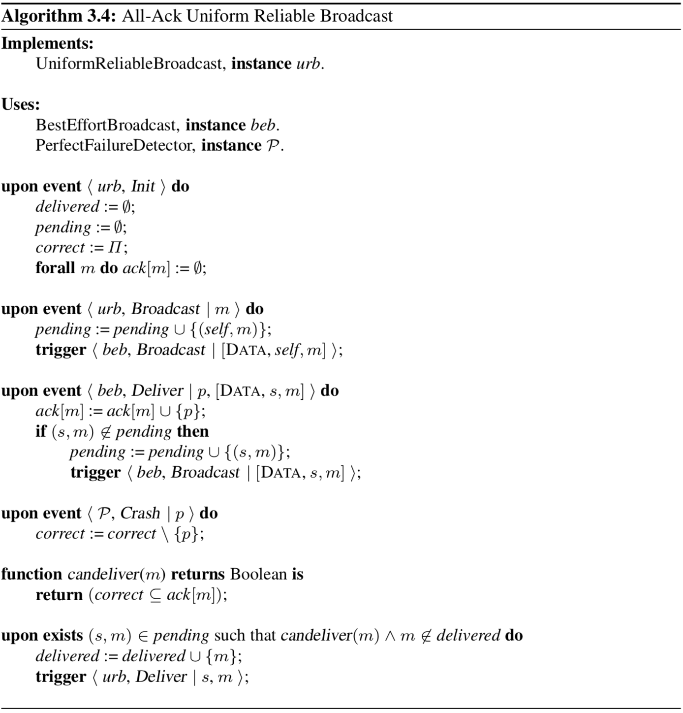
Notes:
Properties:
URB1: Validity: If a correct process p broadcasts a message m, then p eventually delivers m.
follows from the completeness property of the failure detector and from the validity property of the underlying beb
URB2: No duplication: No message is delivered more than once.
delivered variable
URB3: No creation: If a process delivers a message m with sender s, then m was
previously broadcast by process s.
from no-creation of beb
URB4: Uniform agreement: If a message m is delivered by some process (whether correct or faulty), then m is eventually delivered by every correct process.
Performance: Best case: two communication steps first step it sends N messages and in the second step N (N − 1) messages, for a total of N 2 messages
Worst case: processes crash in sequence, N + 1 steps are required

Slide 25
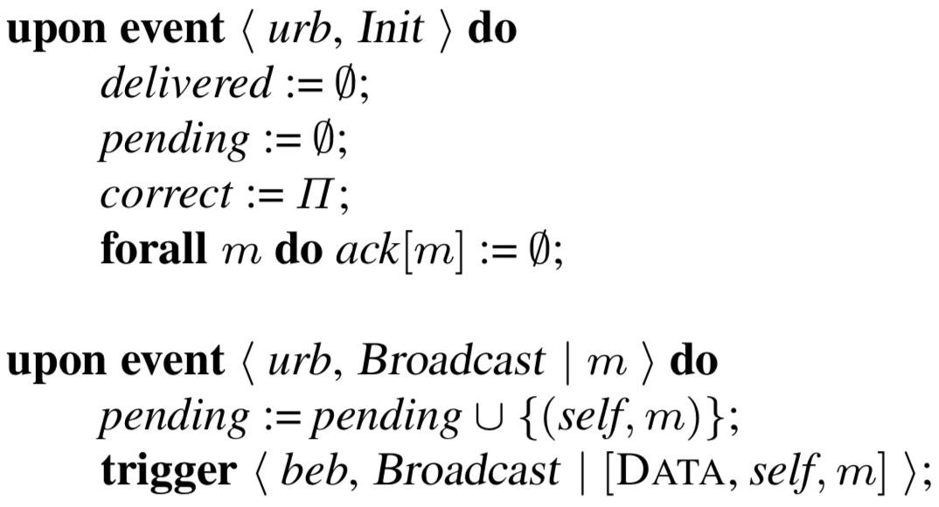
Notes:
Properties:
URB1: Validity: If a correct process p broadcasts a message m, then p eventually delivers m.
URB2: No duplication: No message is delivered more than once.
URB3: No creation: If a process delivers a message m with sender s, then m was
previously broadcast by process s.
URB4: Uniform agreement: If a message m is delivered by some process (whether correct or faulty), then m is eventually delivered by every correct process.

Slide 26
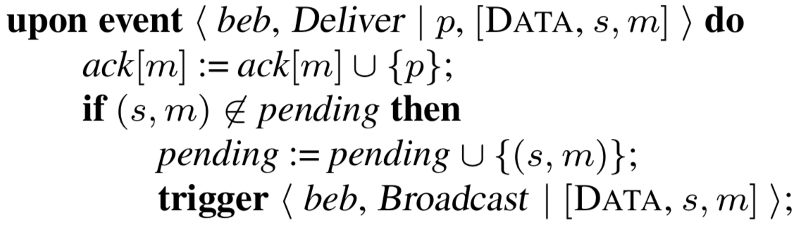
Notes:
Properties:
URB1: Validity: If a correct process p broadcasts a message m, then p eventually delivers m.
URB2: No duplication: No message is delivered more than once.
URB3: No creation: If a process delivers a message m with sender s, then m was
previously broadcast by process s.
URB4: Uniform agreement: If a message m is delivered by some process (whether correct or faulty), then m is eventually delivered by every correct process.

Slide 27
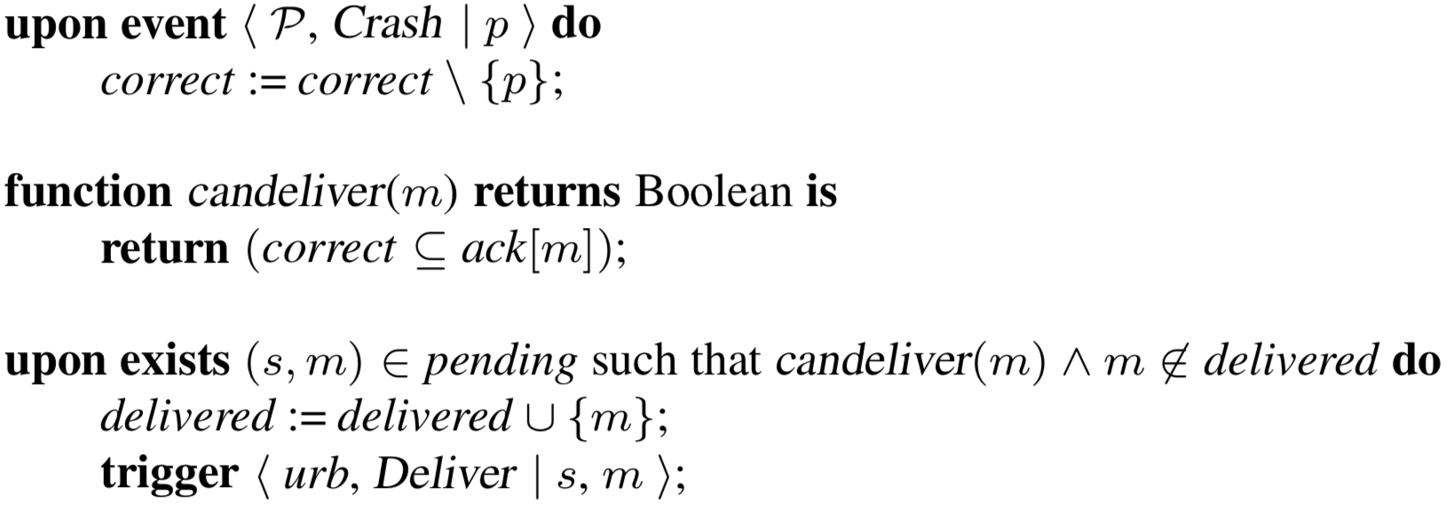
Notes:
Properties:
URB1: Validity: If a correct process p broadcasts a message m, then p eventually delivers m.
URB2: No duplication: No message is delivered more than once.
URB3: No creation: If a process delivers a message m with sender s, then m was
previously broadcast by process s.
URB4: Uniform agreement: If a message m is delivered by some process (whether correct or faulty), then m is eventually delivered by every correct process.

Slide 28
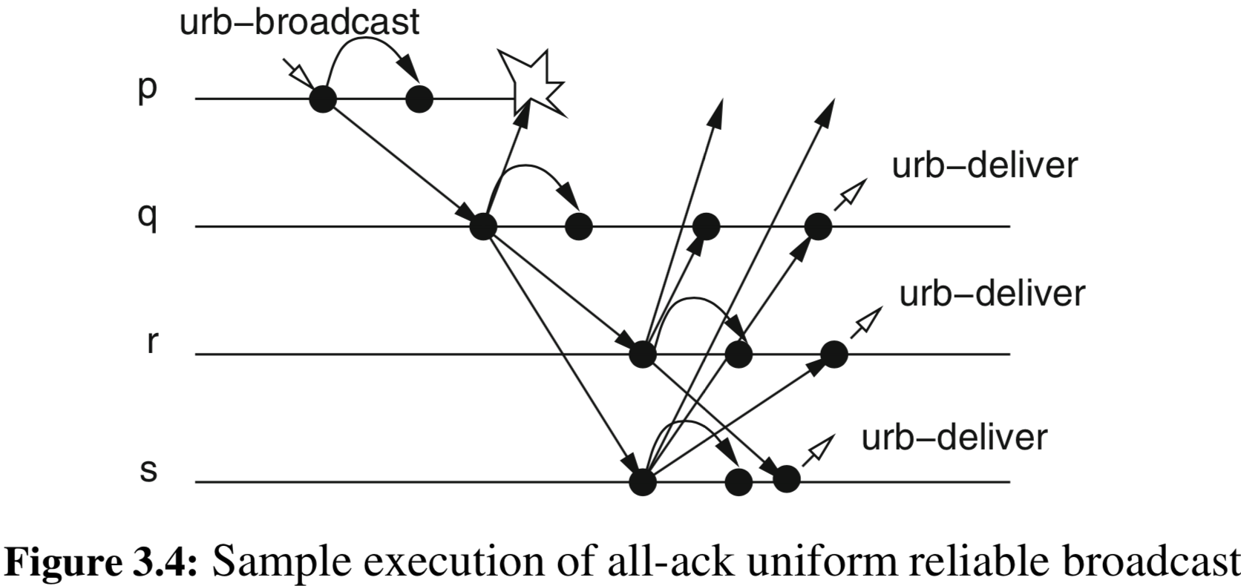
example

Slide 29
uniformity without failure detection
Previous algorithm requires perfect failure detector
Uniform agreement would be violated if accuracy of FD is not satisfied
validity would be violated if completeness of FD is not satisfied
A different approach:
assumes a correct majority of processes
N > 2f if f processes can crash
for fail-silent model
instead of waiting for ACK from all, wait for ACK from majority

Slide 30
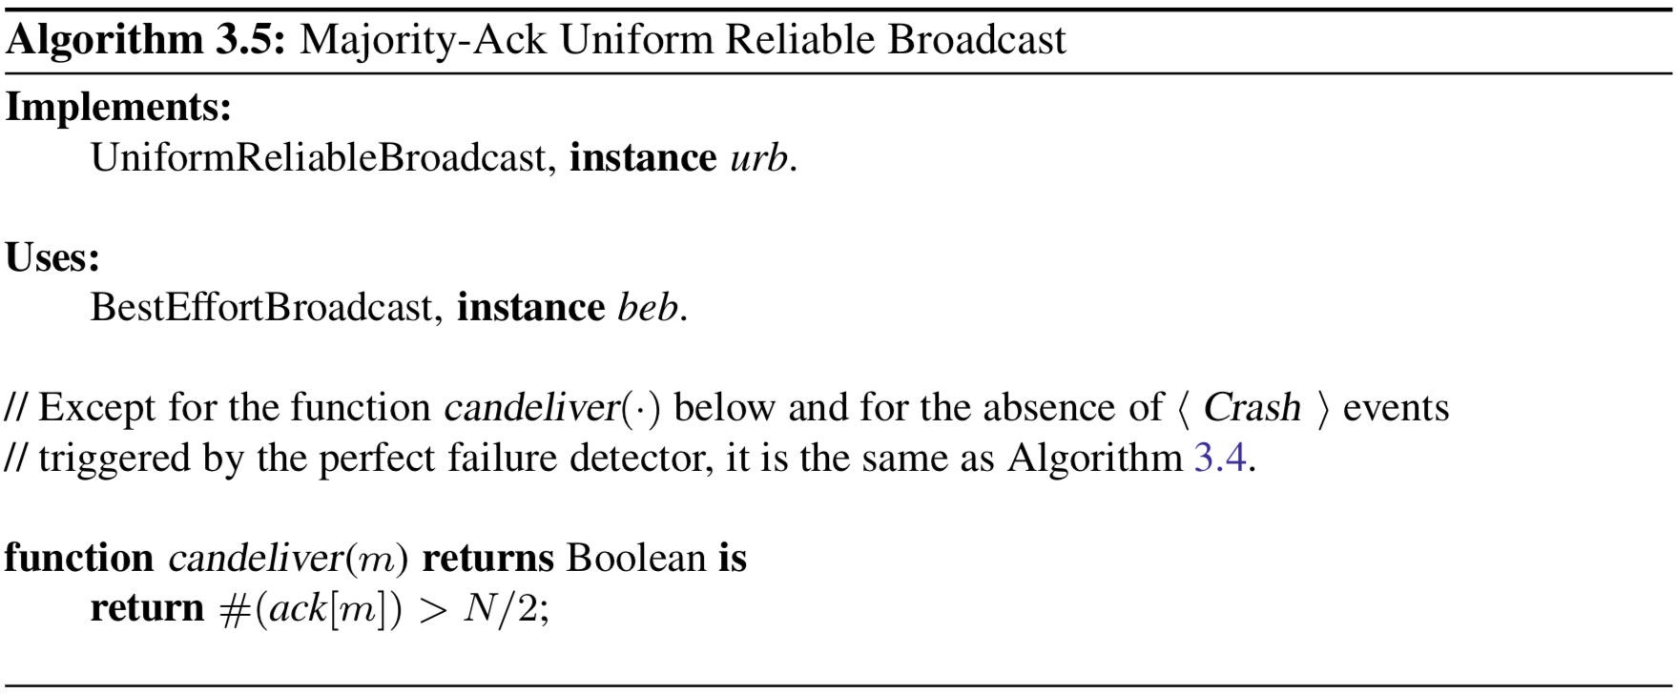
Notes:
Properties:
URB1: Validity: If a correct process p broadcasts a message m, then p eventually delivers m.
URB2: No duplication: No message is delivered more than once.
URB3: No creation: If a process delivers a message m with sender s, then m was
previously broadcast by process s.
URB4: Uniform agreement: If a message m is delivered by some process (whether correct or faulty), then m is eventually delivered by every correct process.

Slide 31
stubborn broadcast
For the fail-recovery model
Reminiscent of the stubborn links
No need to log anything in stable storage, just send everything forever
if a process crashes and later recovers, it will eventually get these infinitely many messages
not necessarily the most useful or efficient…

Slide 32
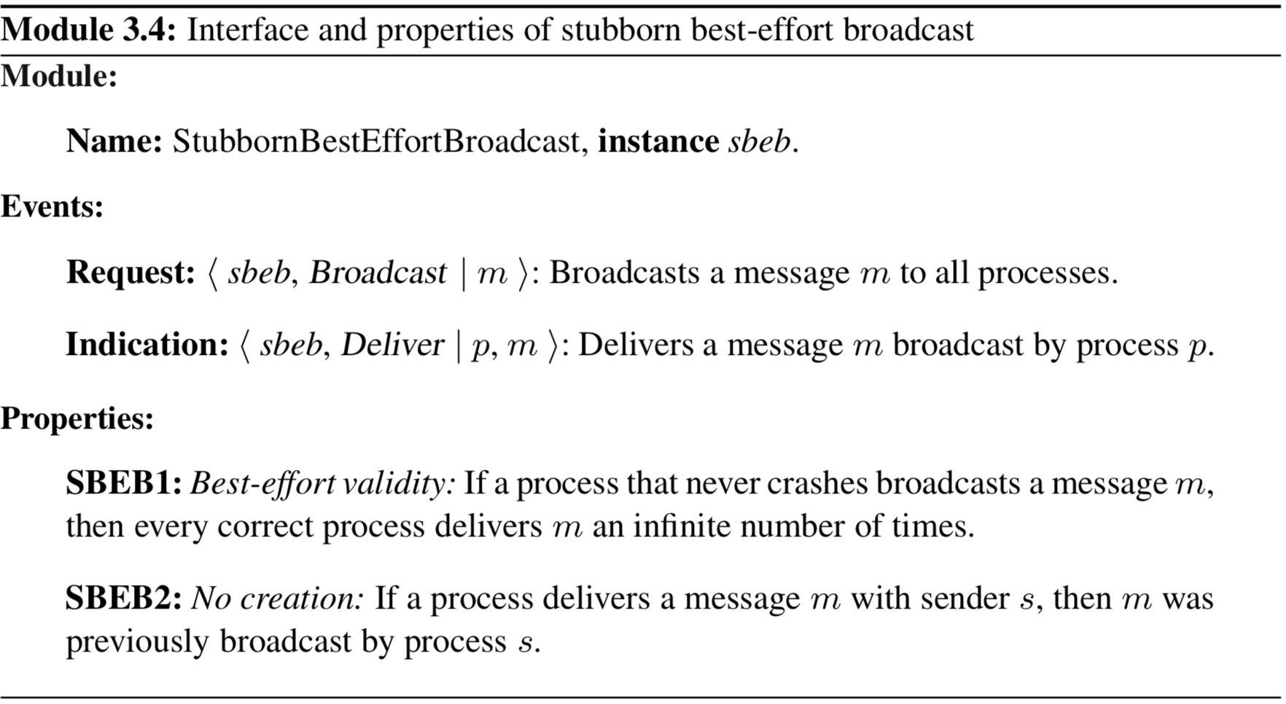
stubborn broadcast

Slide 33
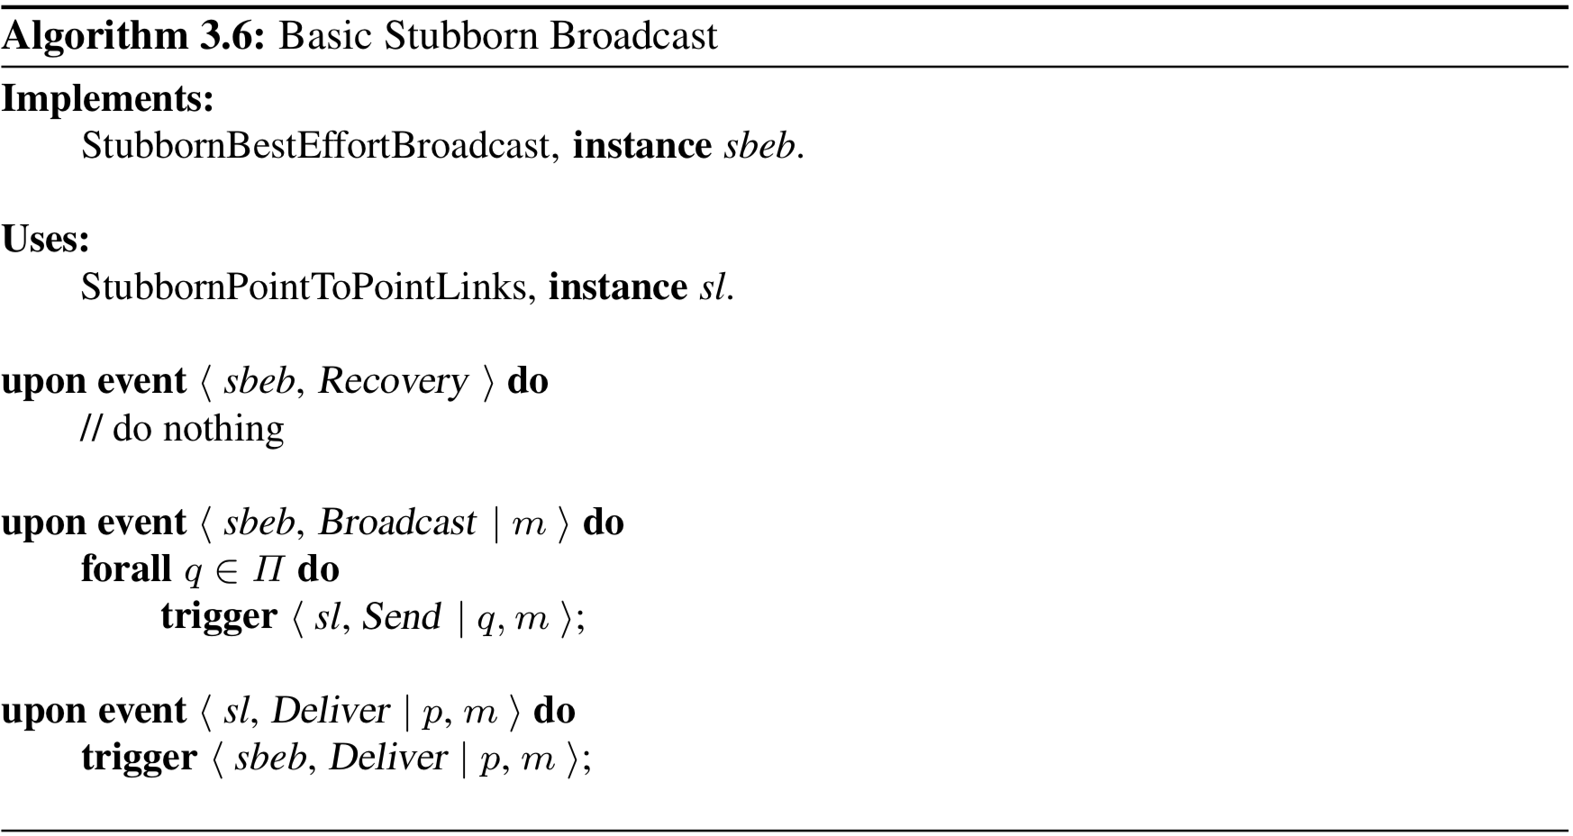
stubborn broadcast
Notes:
SBEB1: Best-effort validity: If a process that never crashes broadcasts a message m, then every correct process delivers m an infinite number of times.
SBEB2: No creation: If a process delivers a message m with sender s, then m was previously broadcast by process s.

Slide 34
logged best-effort broadcast
Also for fail-recovery model
More practically just logs delivered stuff in stable storage
A deliver event notifies upper layer that a variable has been stored
upper layer can decide when/how it wants to retrieve that variable data

Slide 35
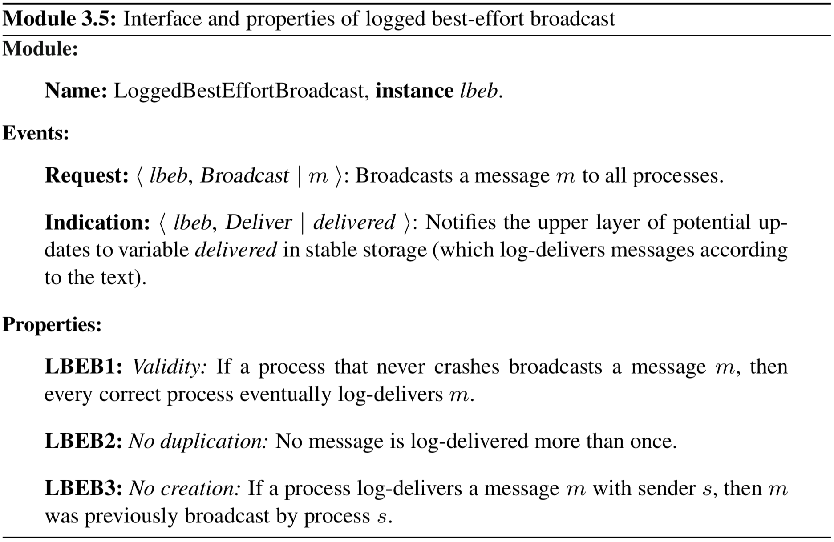
logged best-effort broadcast

Slide 36
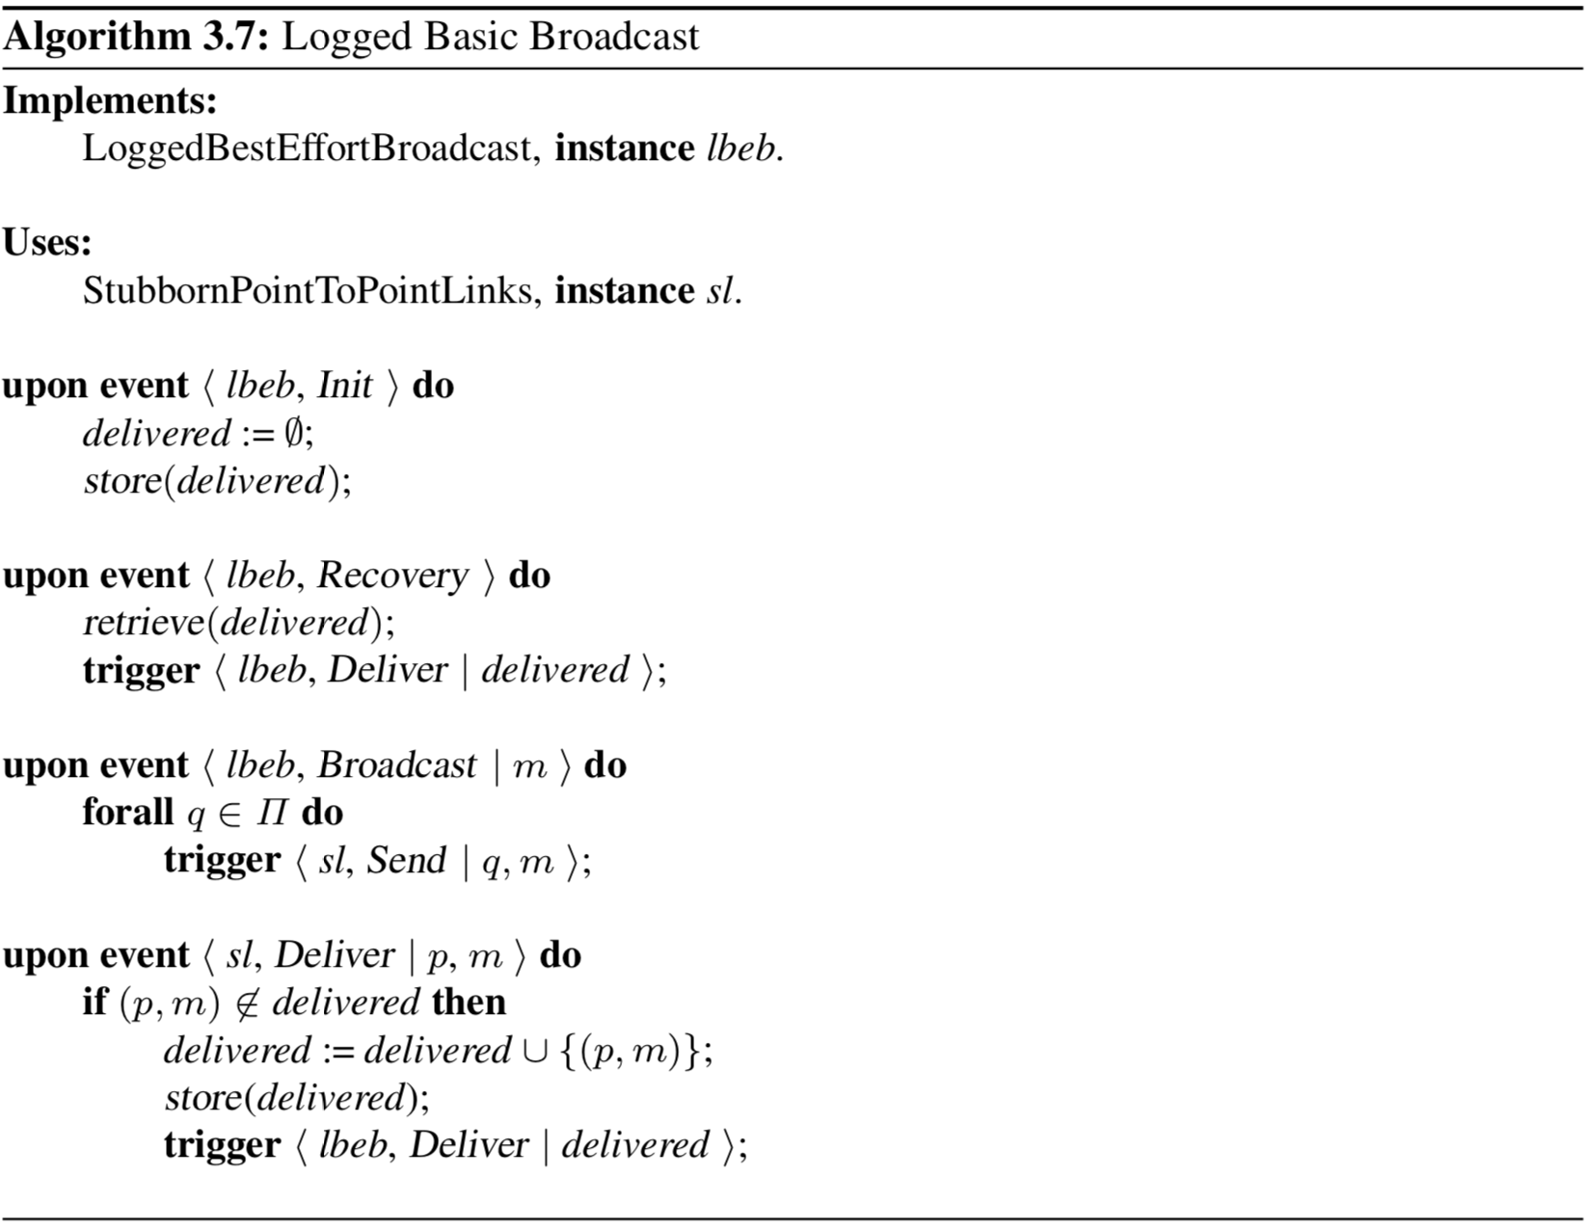
Notes:
Properties:
LBEB1: Validity: If a process that never crashes broadcasts a message m, then
every correct process eventually log-delivers m.
LBEB2: No duplication: No message is log-delivered more than once.
LBEB3: No creation: If a process log-delivers a message m with sender s, then m was previously broadcast by process s.
Performance: single communication step for a process to deliver a message, and exchanges at least N messages

Slide 37
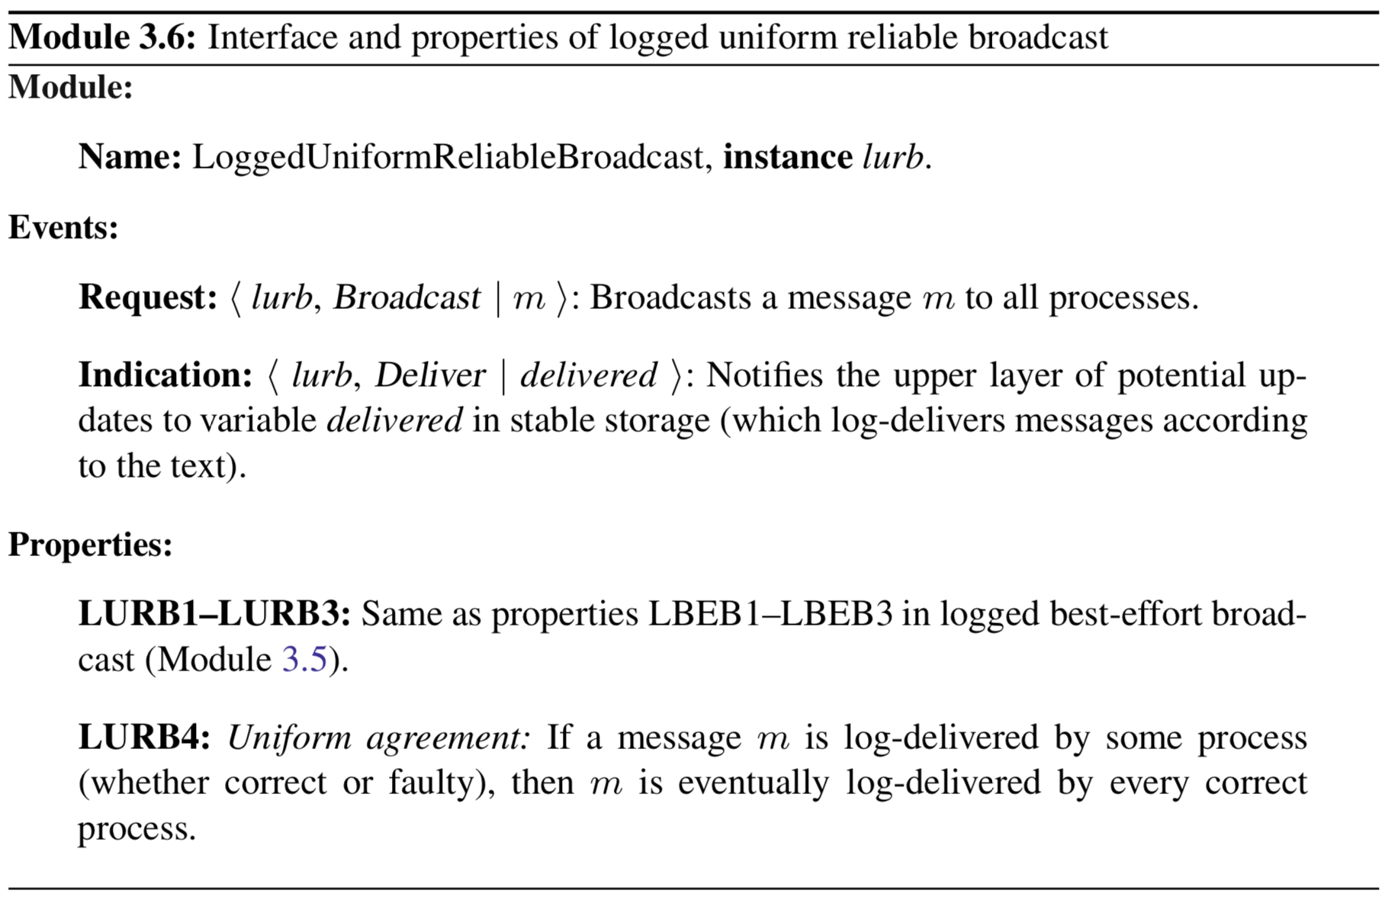
logged uniform reliable broadcast

Slide 38
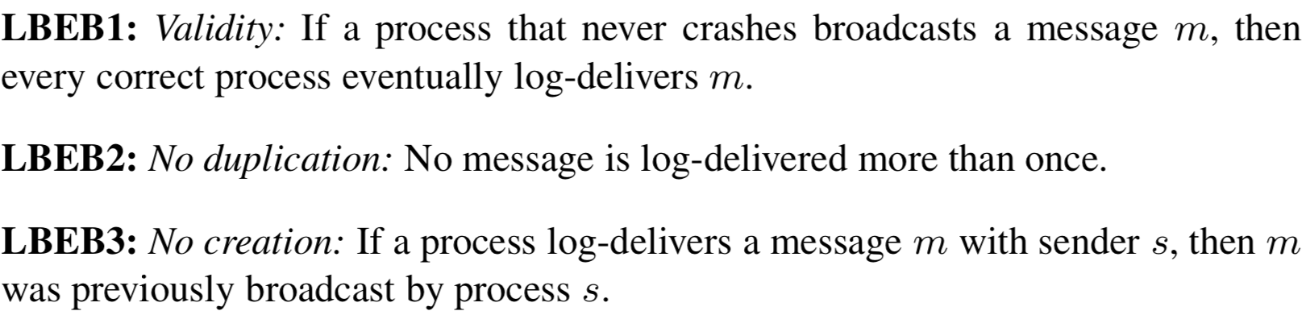
logged uniform reliable broadcast
Notes:
Properties:
LURB1: Validity: If a process that never crashes broadcasts a message m, then
every correct process eventually log-delivers m.
LURB2: No duplication: No message is log-delivered more than once.
LURB3: No creation: If a process log-delivers a message m with sender s, then m was previously broadcast by process s.
LURB4: Uniform agreement: If a message m is log-delivered by some process (whether correct or faulty), then m is eventually log-delivered by every correct process.

Slide 39
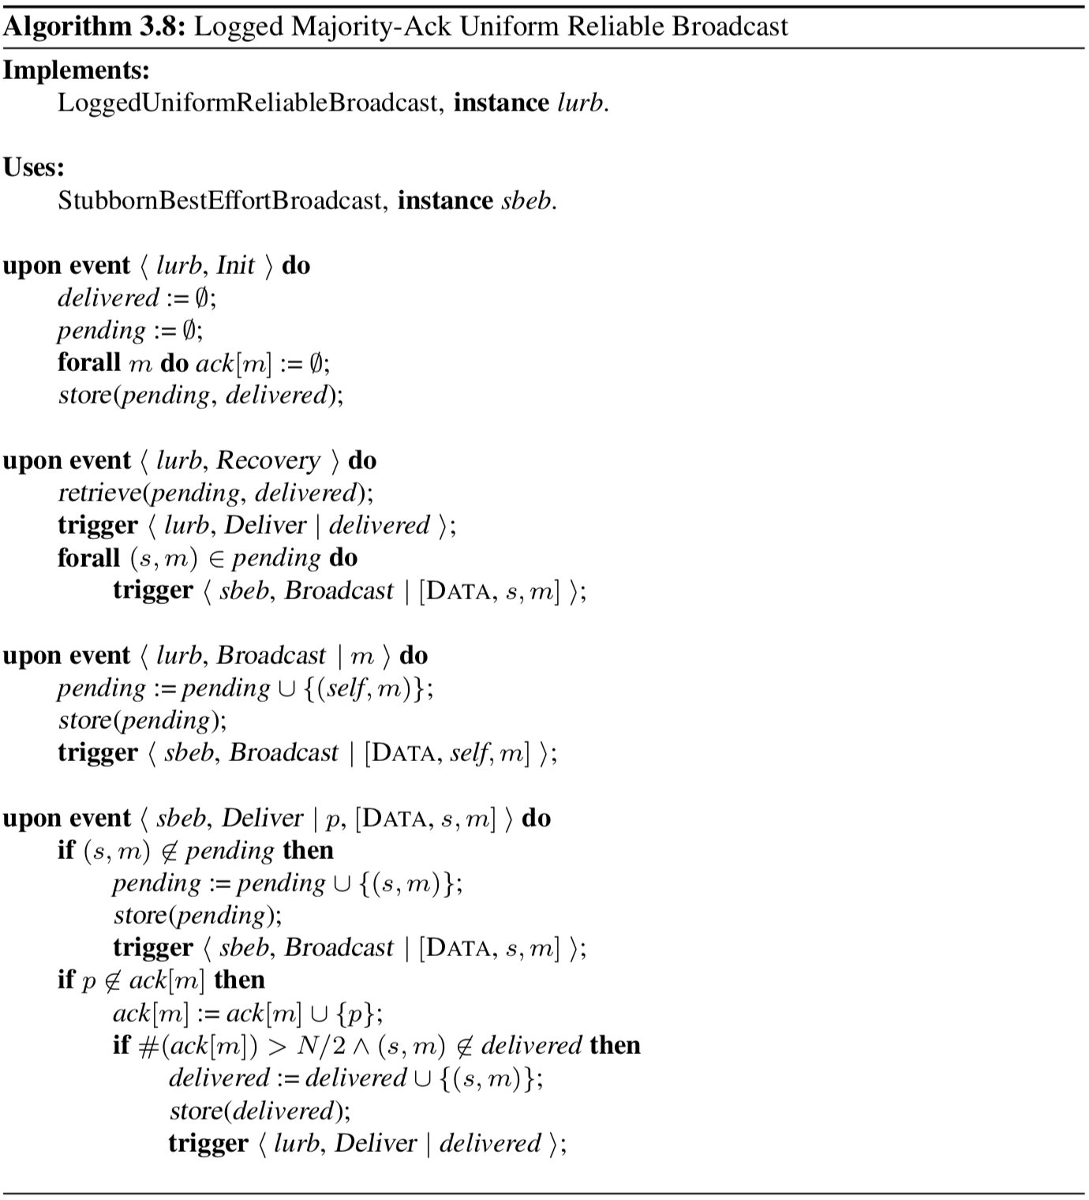

Slide 40
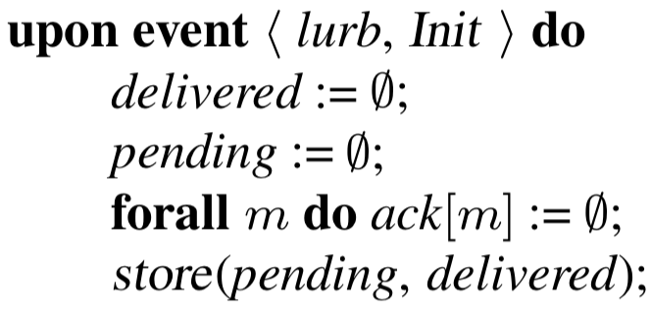

Slide 41
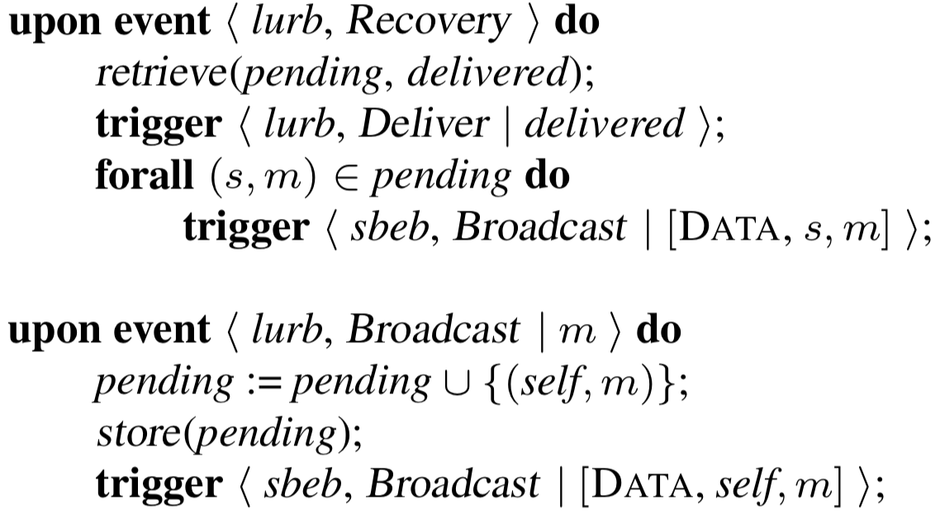

Slide 42
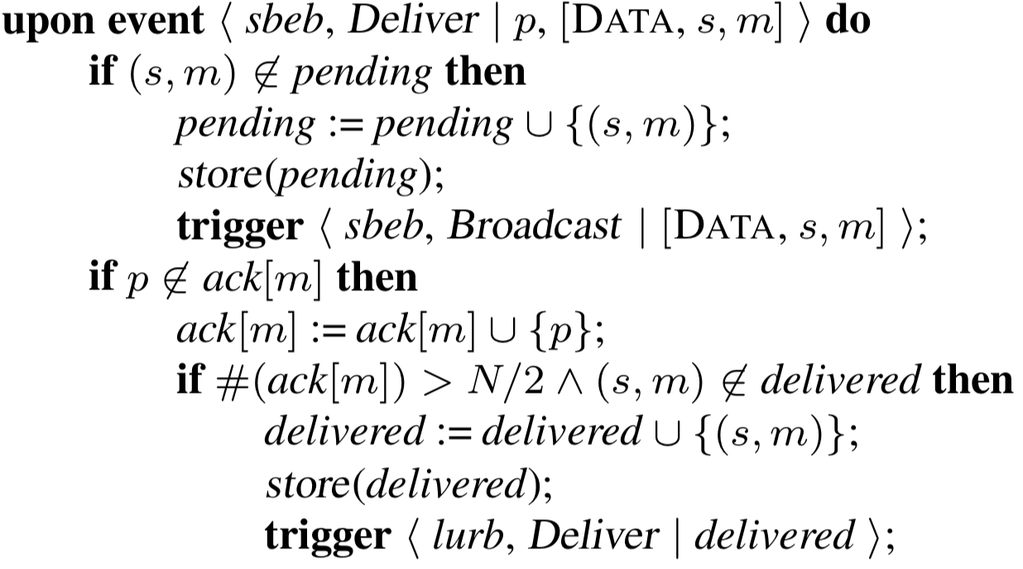

Slide 43
ordering
Broadcast algorithms thus far have NOT made any guarantees about ordering
messages can be received out-of-order
We will be adding ordering guarantees to our algorithms
FIFO — First-in first-out ordering with respect to a single sender
Causal — Guarantees that if one message m1 “causes” another m2, then m1 is delivered before m2
Total order (will look at later)

Slide 44
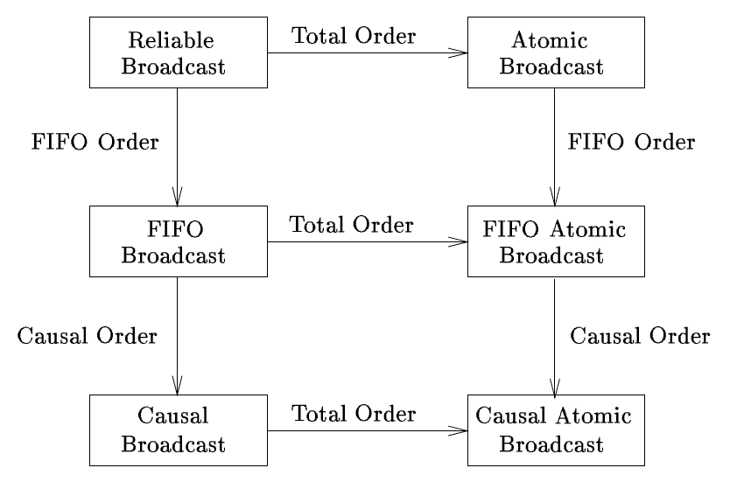
From one to another

Slide 45
ordering needed?
Consider a distributed message board with:
proposals
comments on previous proposals
Board application is replicated at every process for high-availability
can simply use broadcast to disseminate proposals and comments
It could happen that someone makes a proposal and sends m1
Following, maybe the person changes his/her mind and sends new proposal m2
Reliable broadcast could cause some process to deliver m2 before m1
It could also happen that someone makes a proposal and sends m1
Following, someone posts a comment on that proposal m2
Reliable broadcast could cause some process to deliver m2 before m1

Slide 46
fifo order
Orders all messages sent from the same process
Does NOT affect messages from different senders
There are different variants of FIFO-order broadcast
Uniform and non-uniform

Slide 47
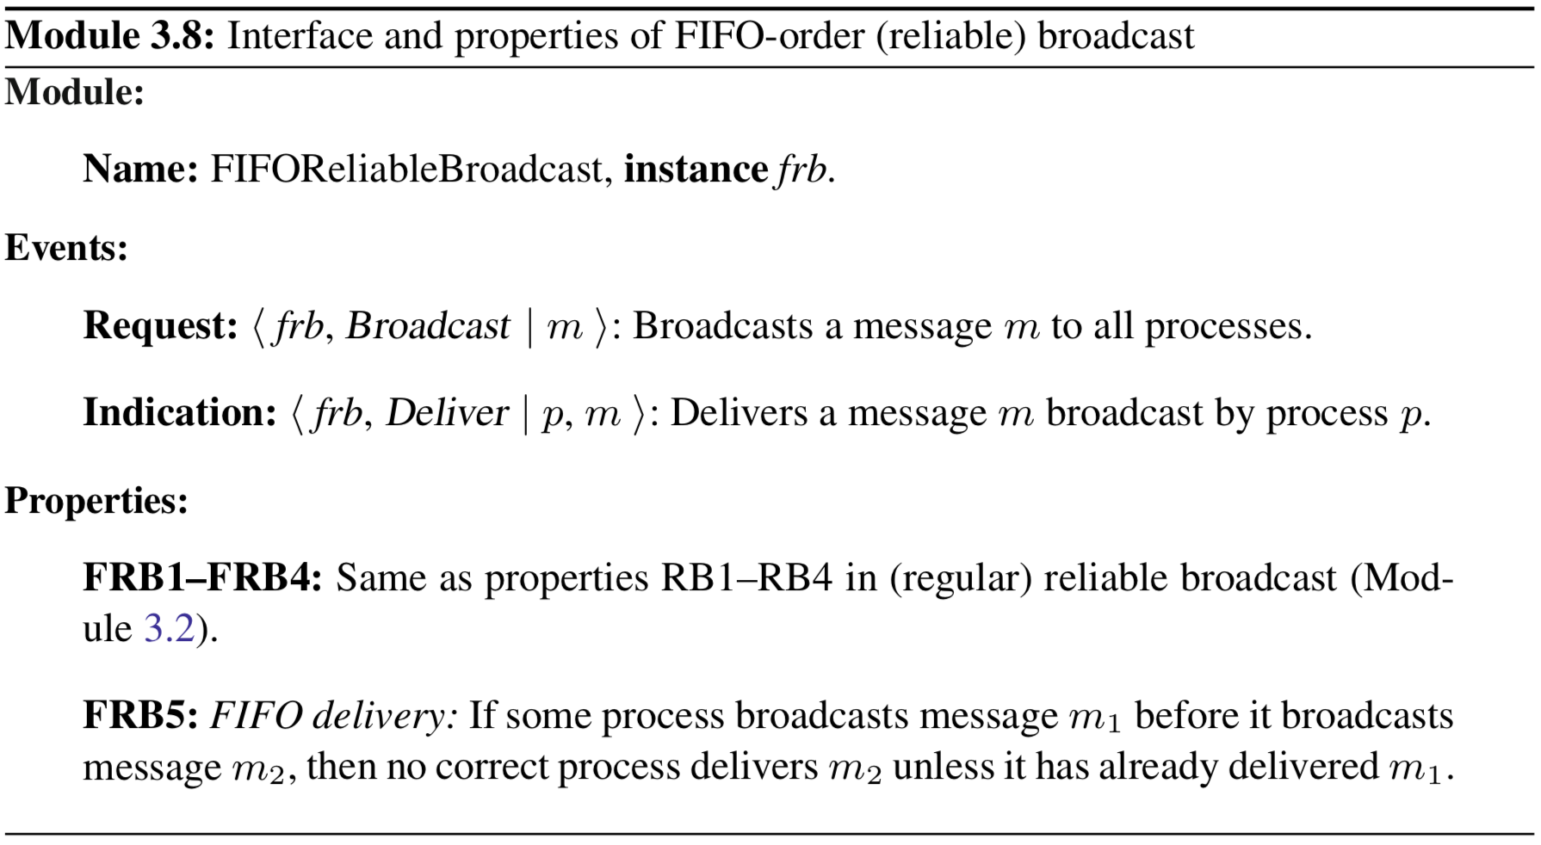
fifo-order broadcast

Slide 48
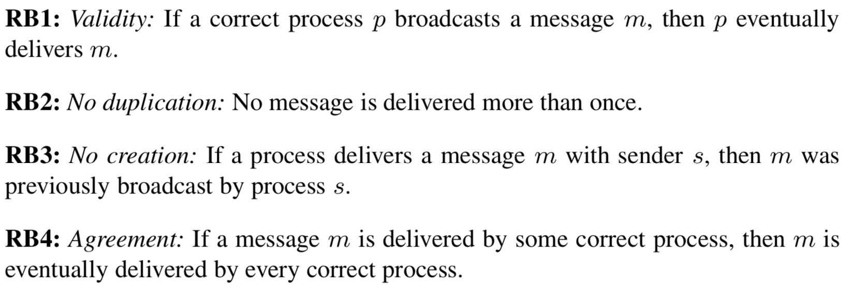
fifo-order broadcast

Slide 49
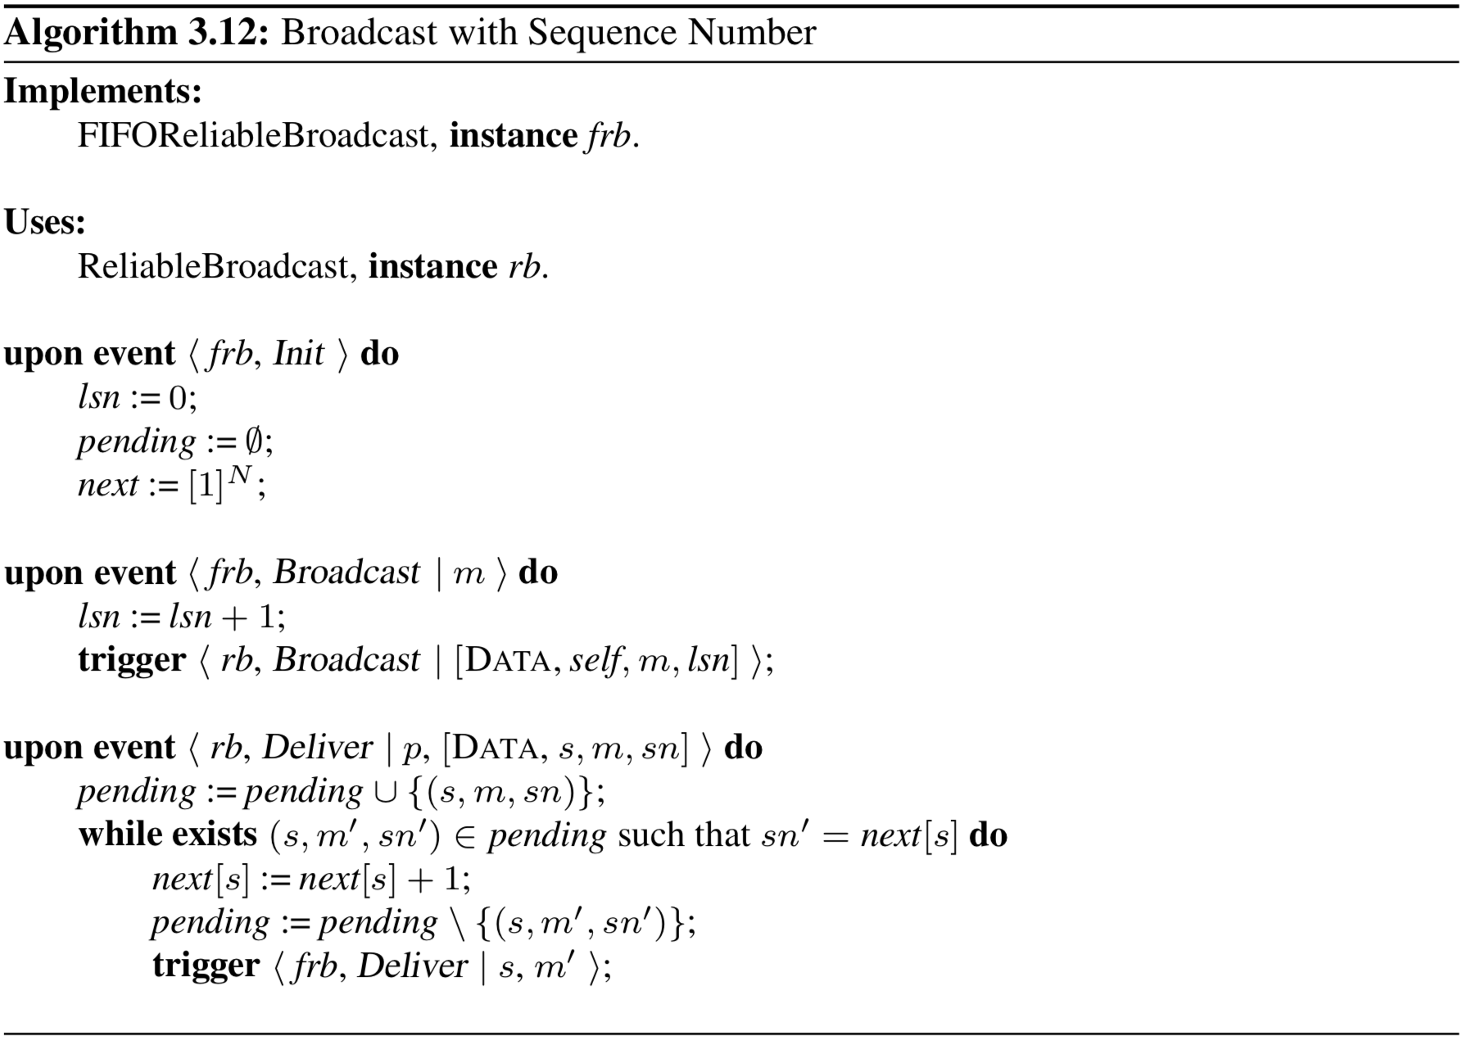
Notes:
Properties:
FRB1: Validity: If a correct process p broadcasts a message m, then p eventually delivers m.
FRB2: No duplication: No message is delivered more than once.
FRB3: No creation: If a process delivers a message m with sender s, then m was
previously broadcast by process s.
FRB4: Agreement: If a message m is delivered by some correct process, then m is eventually delivered by every correct process.
FRB5: FIFO delivery: If some process broadcasts message m1before it broadcasts message m2, then no correct process delivers m2unless it has already delivered m1.
Performance: does not add anything significant to reliable broadcast

Slide 50
causal-order broadcast
Want to respect cause-effect relationships
Captured with the happens-before relation (also called causal relation)
m1 may have potentially caused some m2, denoted as m1 → m2 if (one of the following):
some process p broadcasts m1 before it broadcasts m2
some process p delivers m1 and subsequently broadcasts m2
there exists some message m′ such that m1 → m′ and m′ → m2

Slide 51
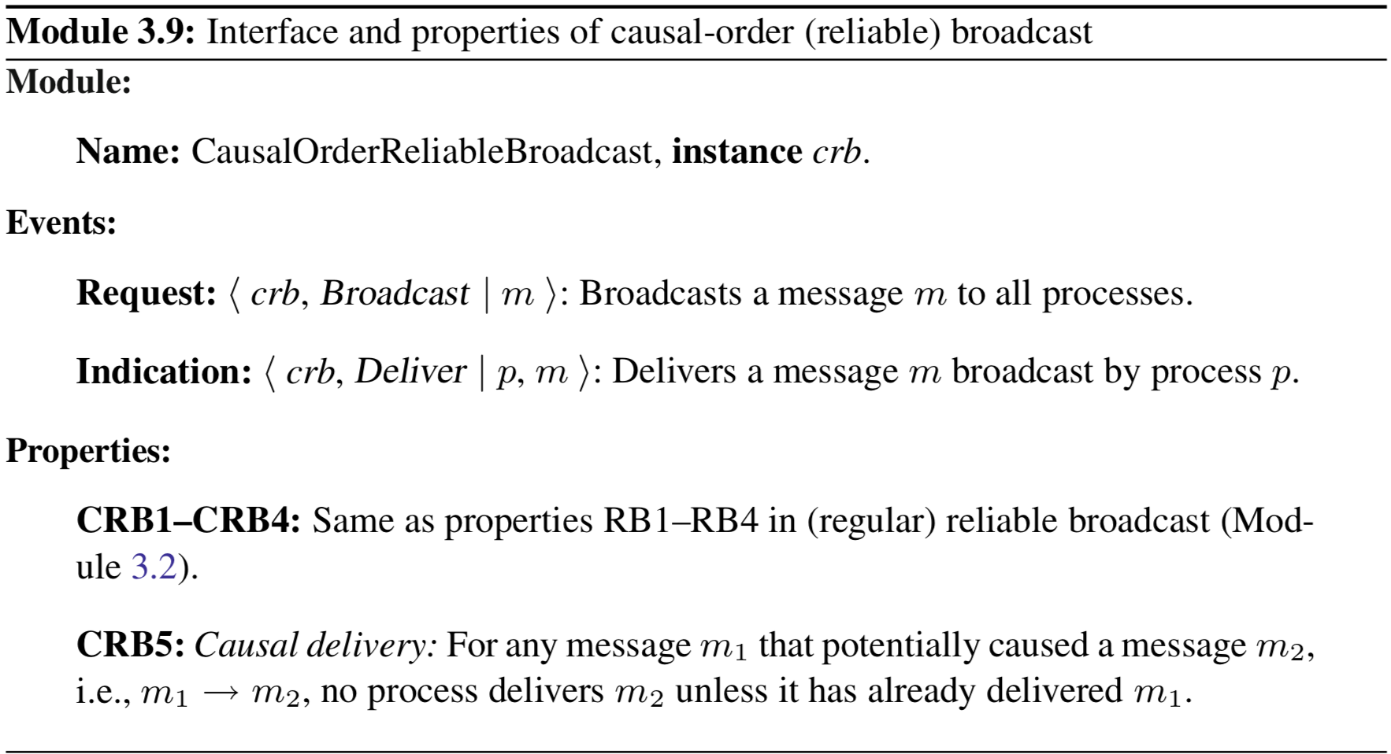
causal order broadcast

Slide 52
causal order broadcast

Slide 53
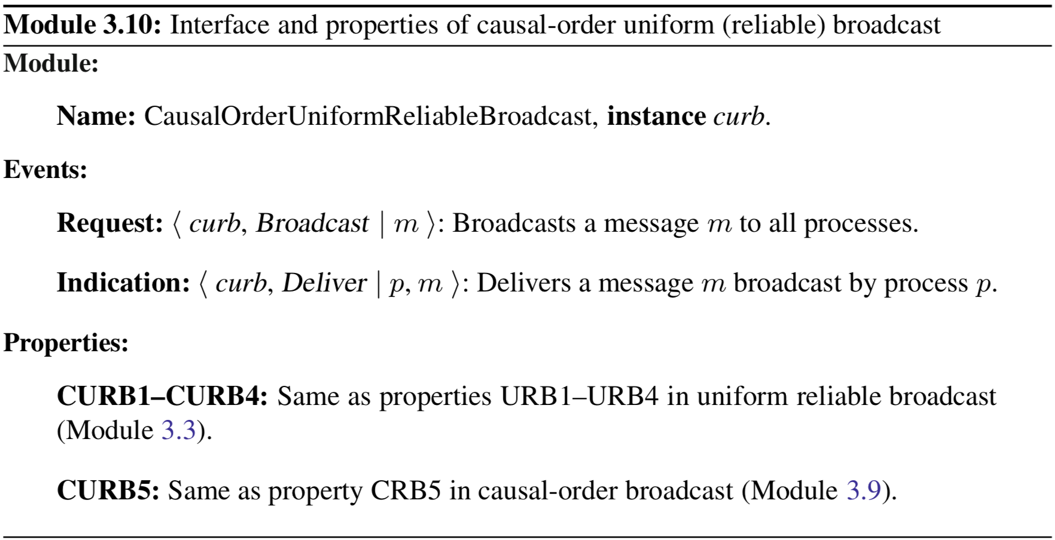
causal order uniform (reliable) broadcast

Slide 54
causal order uniform (reliable) broadcast

Slide 55
Causal Order - Alternative definition
We can also define causal order to be:
FIFO Order + Local Order
Local Order - If a process broadcasts a message m, and a process delivers m before broadcasting a message m’, then no correct process delivers m’ unless it has previously delivered m.

Slide 56
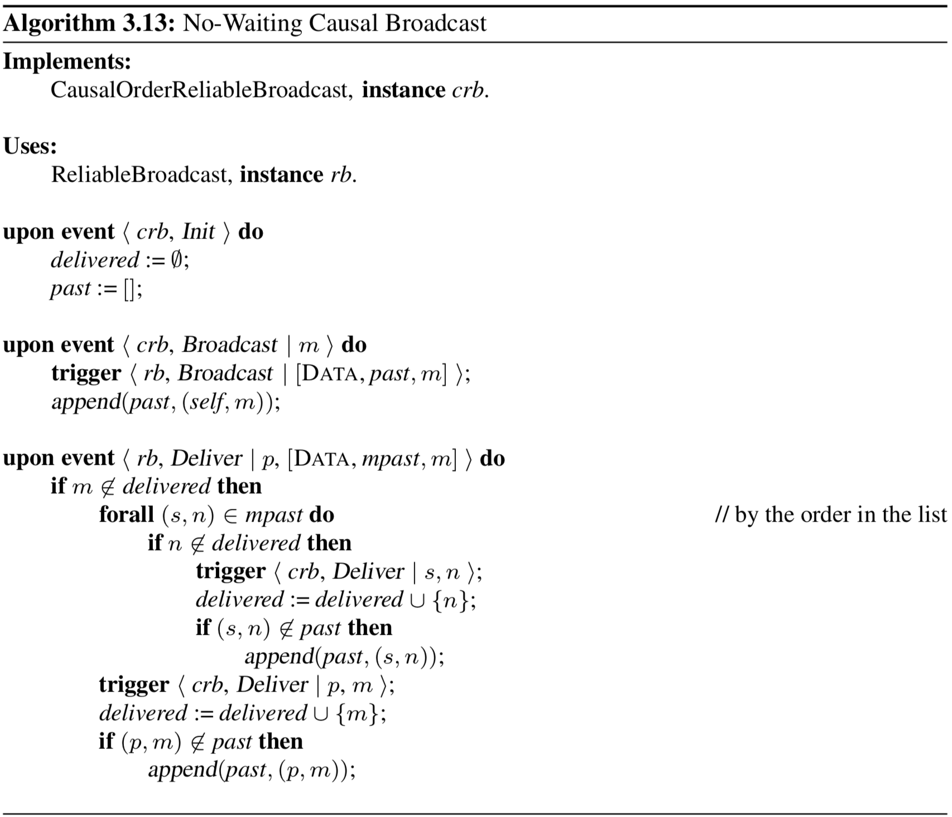
Notes:
For fail-silent model
Can implement uniform variant by using underlying uniform-reliable broadcast instead
Properties:
CRB1: Validity: If a correct process p broadcasts a message m, then p eventually delivers m.
CRB2: No duplication: No message is delivered more than once.
CRB3: No creation: If a process delivers a message m with sender s, then m was
previously broadcast by process s.
CRB4: Agreement: If a message m is delivered by some correct process, then m is eventually delivered by every correct process.
CRB5: Causal delivery: For any message m1that potentially caused a message m2, i.e., m1 → m2, no process delivers m2 unless it has already delivered m1.
Performance: no added messages, but message SIZE can grow quite large…

Slide 57
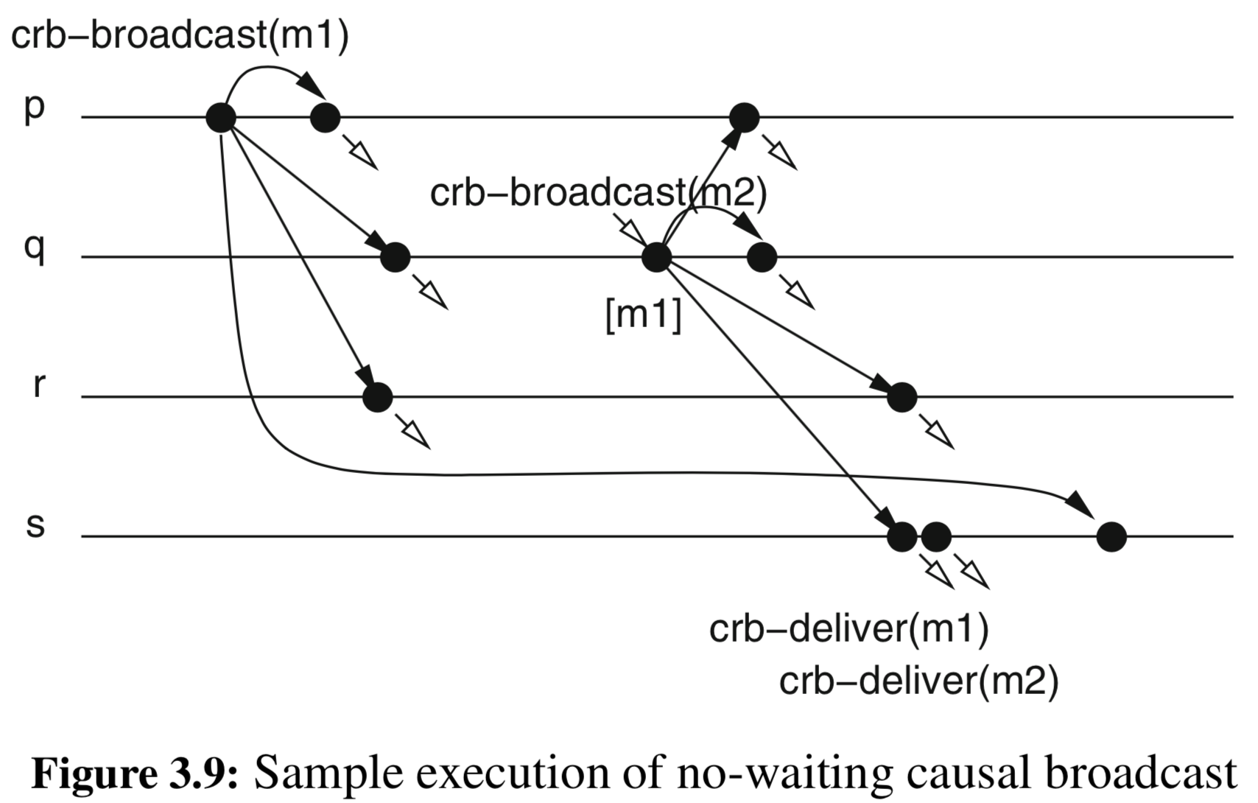
causal-order broadcast example

Slide 58
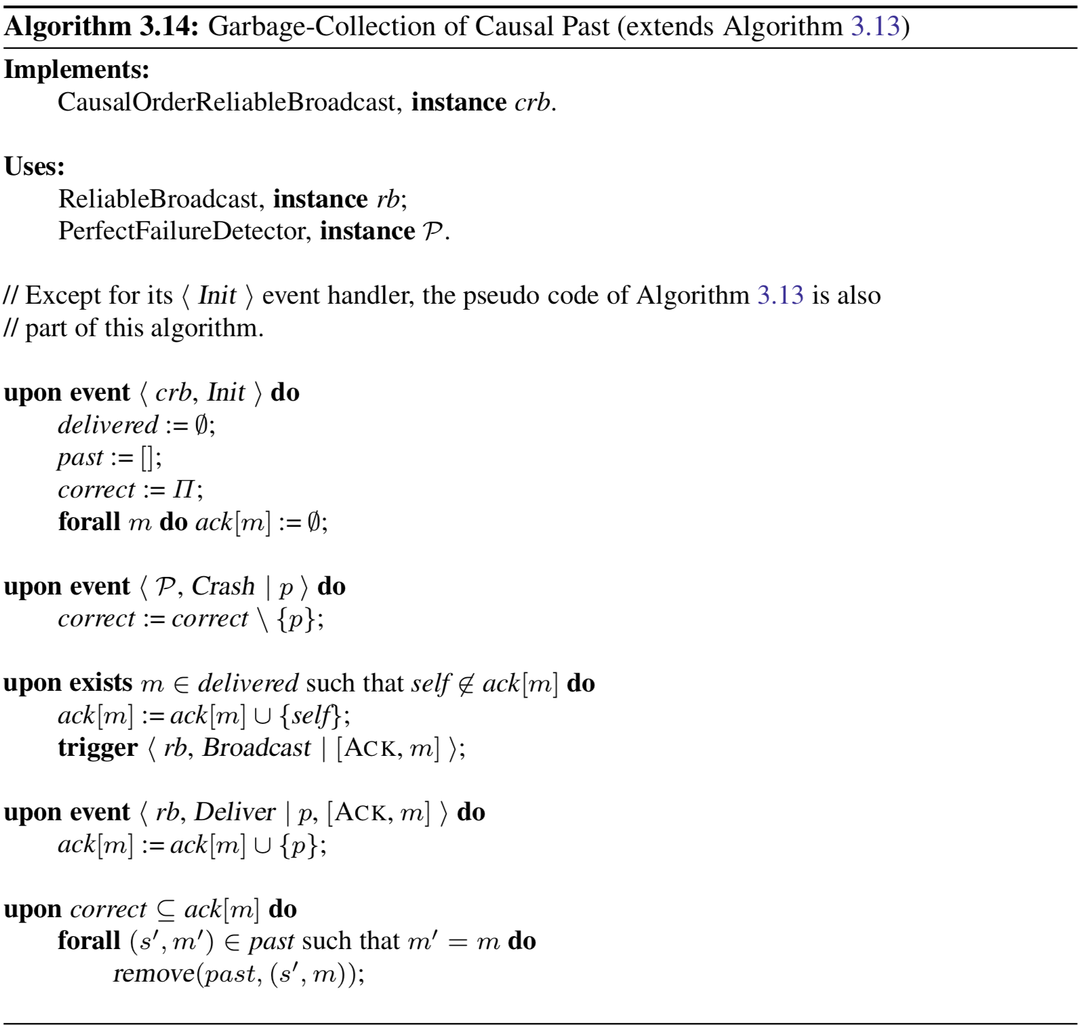
Notes:
Adding garbage collection to the previous algorithm
The algorithm purges a message only if this message has been rb-delivered by all correct processes
Performance: every acknowledgment message disseminated through reliable broadcast adds O(N²) messages

Slide 59
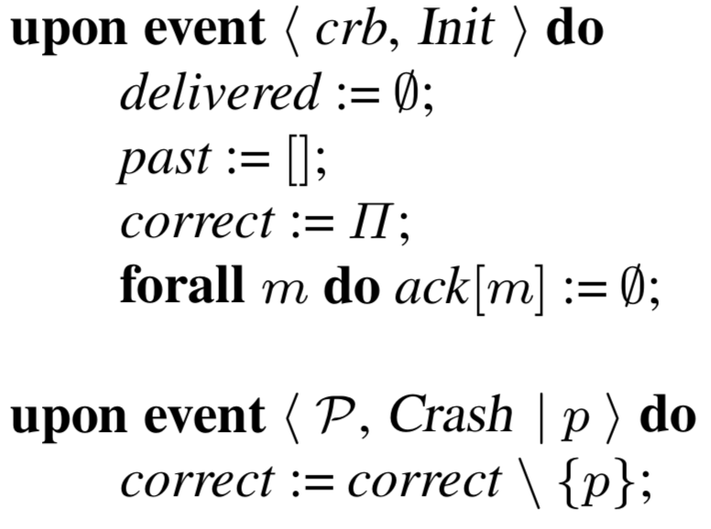
Notes:
Adding garbage collection to the previous algorithm
The algorithm purges a message only if this message has been rb-delivered by all correct processes
Performance: every acknowledgment message disseminated through reliable broadcast adds O(N²) messages

Slide 60
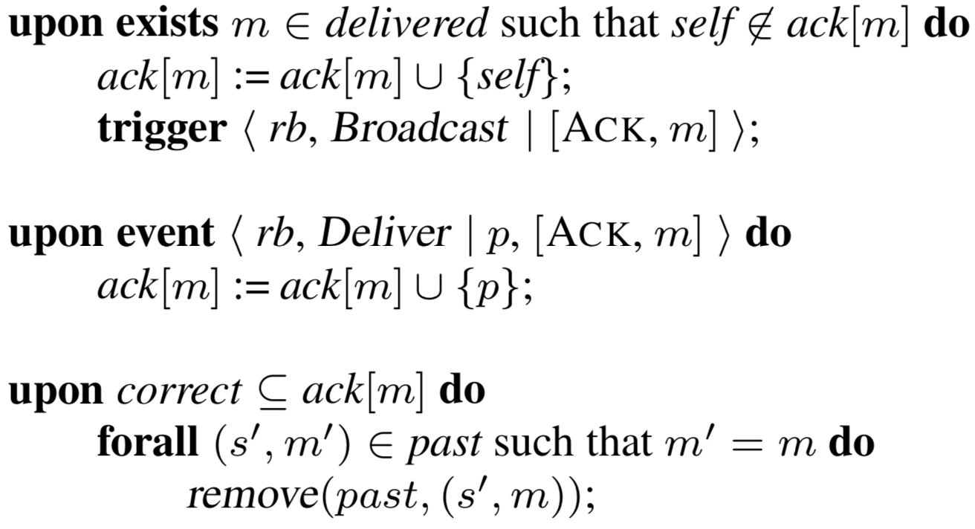
Notes:
Adding garbage collection to the previous algorithm
The algorithm purges a message only if this message has been rb-delivered by all correct processes
Performance: every acknowledgment message disseminated through reliable broadcast adds O(N²) messages

Slide 61
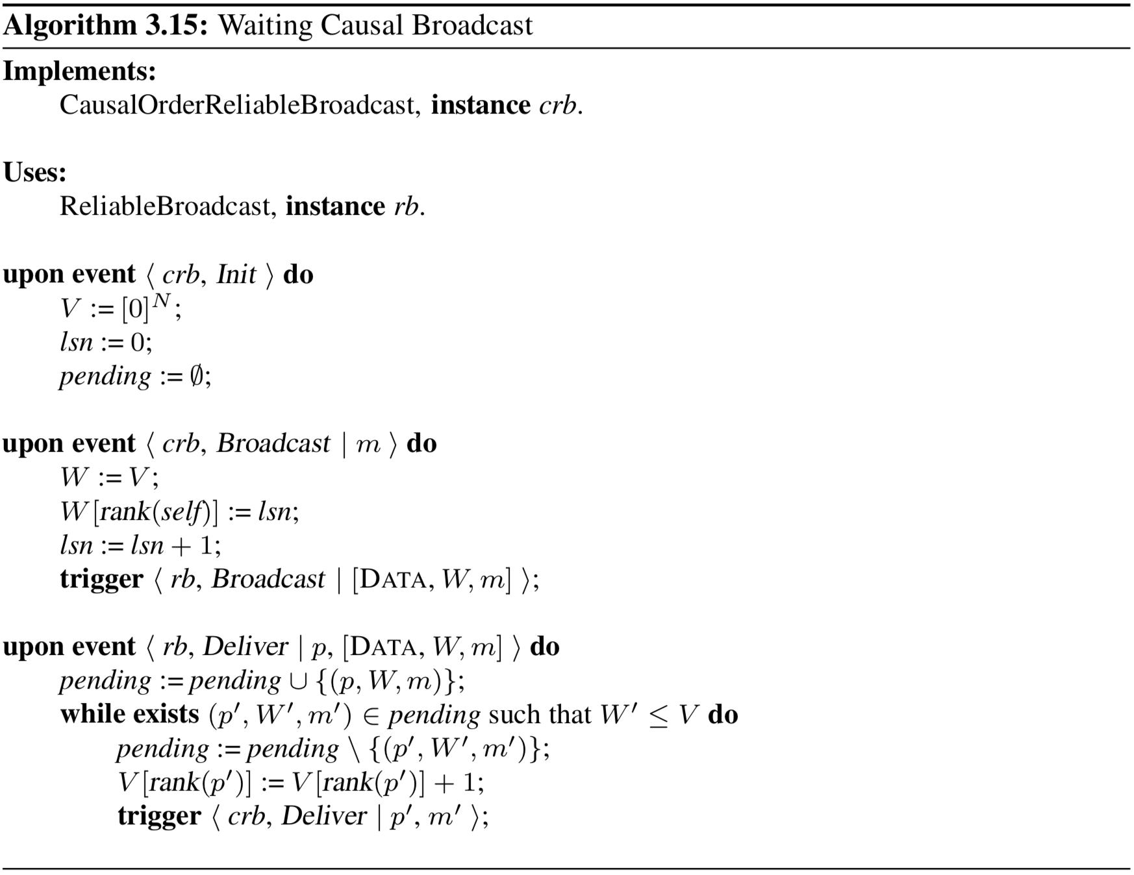
Notes:
Previous approach could get too expensive
This approach sacrifices waiting to bring down load (replacing rb with uniform variant gives causal-order uniform broadcast)
represents the past with a vector of sequence numbers called vector clock
entry V [rank(q)] represents the number of messages that p has crb-delivered from process q
v ≤w whenever it holds for every i = 1,...,N that v[i] ≤w[i]

Slide 62
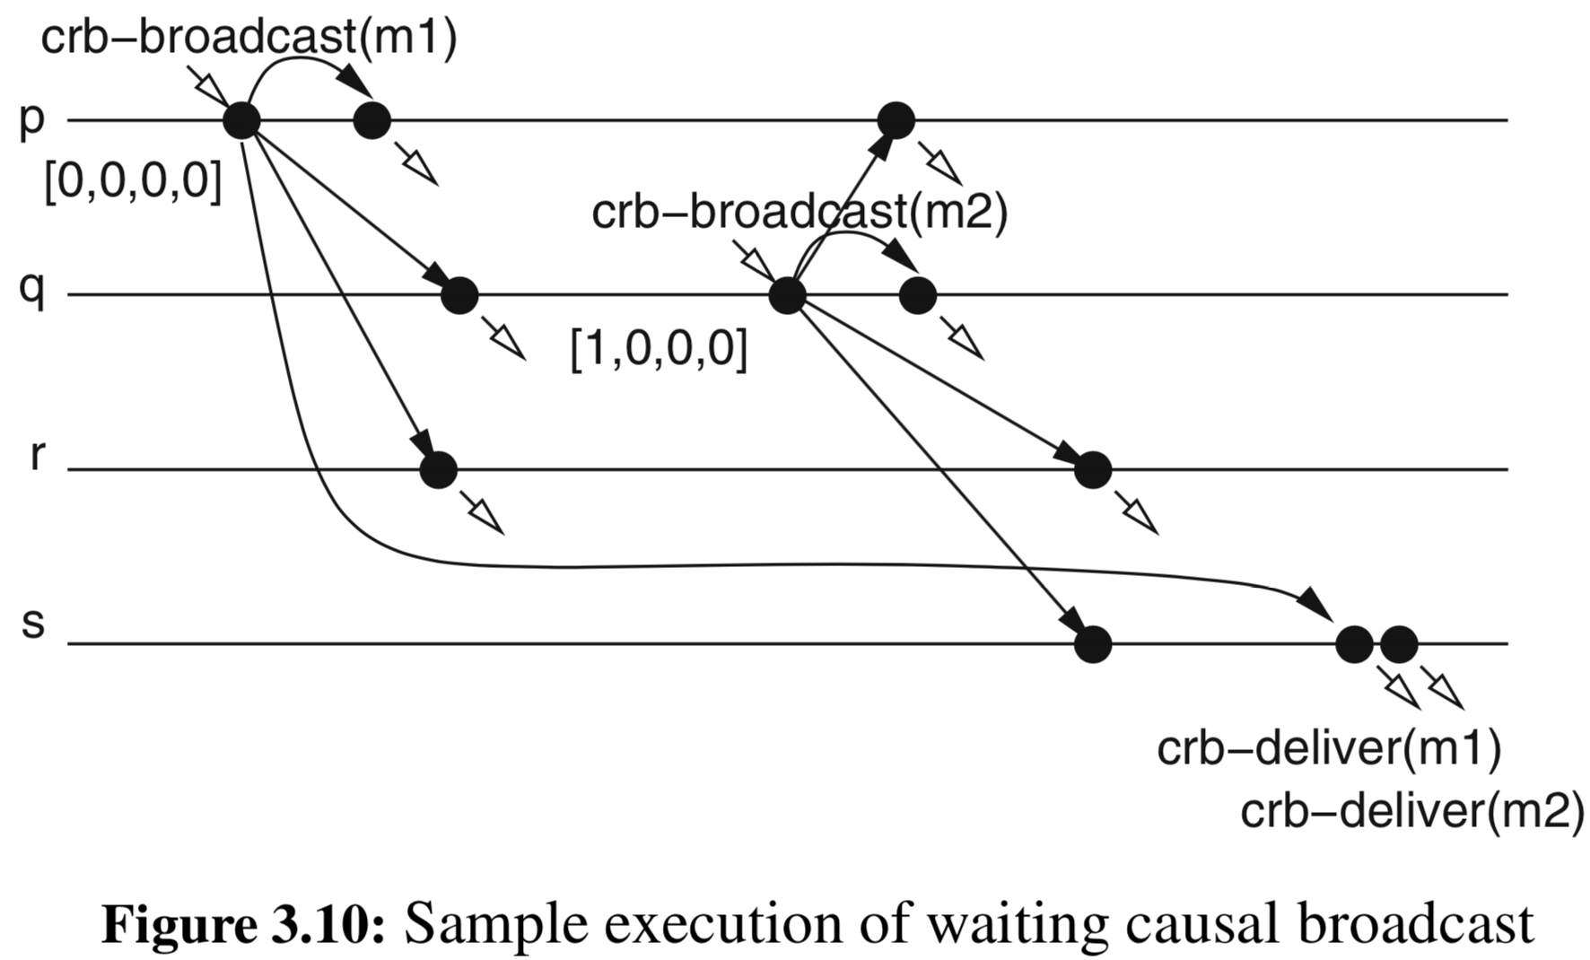
example

Slide 63
Total Order broadcast (AKA Atomic broadcast)
We will discuss this later…
but there are variants of Atomic Broadcast:
FIFO Atomic
Causal Atomic

Slide 64
Timed Broadcast
Some applications have timing requirements on message delivery
A message should be delivered within a bounded time after it was broadcast
called Δ-Timeliness
elapsed time can be interpreted 2 ways:
real time as measured by an external observer
local time as measured by the local clocks of processes

Slide 65
Δ-Timeliness
Real-Time Δ-Timeliness — There is a known constant Δ such that if a message m is broadcast at real time t, then no correct process delivers m after real time t + Δ
Local-Time Δ-Timeliness — There is a known constant Δ such that no correct process p delivers a message m after local time ts(m) + Δ on p’s clock
Satisfying one of the two makes a Timed Broadcast
Uniform versions exist…
Impossible in a fully asynchronous system

Slide 66
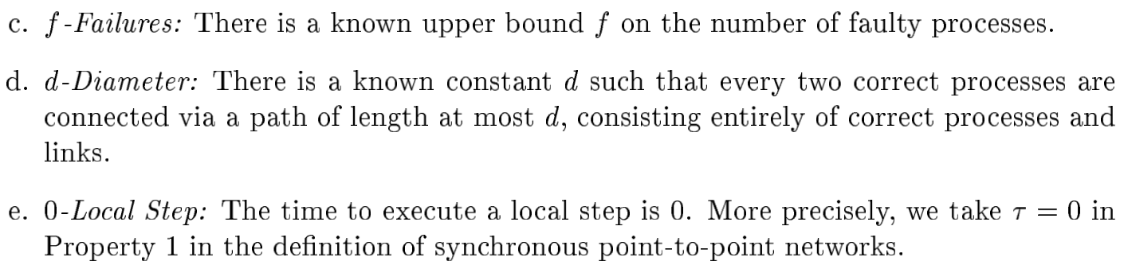
Assumptions needed to achieve Δ-Timeliness
Notes:
Third one not necessary but does simplify things.

Slide 67
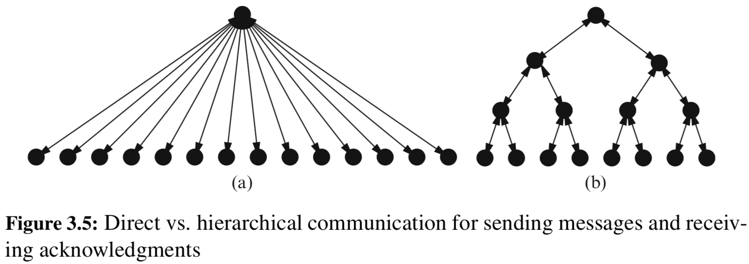
probabilistic broadcast
Reliability can be very (prohibitively) expensive
Uses randomized algorithm
Do NOT provide deterministic guarantees
only make probabilistic claims about such guarantees
Can often achieve “good” reliability
For many reliable algorithms, scale is an issue
ACK implosion

Slide 68
“epidemic” dissemination
Modeled after the natural spread of an epidemic through a population
The idea:
Start with a single “infected” process
Each infected process randomly “infects” a few other processes
Continue until the infection has spread throughout
Same idea as “rumor spreading” and “gossiping”
Often called epidemic, rumor mongering, gossip, or probabilistic broadcast algorithms

Slide 69
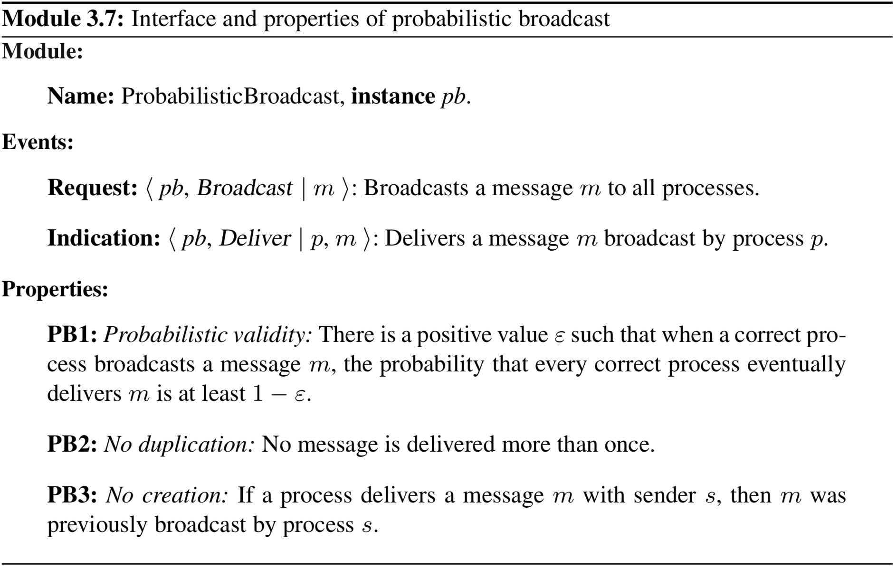
probabilistic broadcast
Notes:
processes can only fail by crashing in this model

Slide 70
probabilistic broadcast algorithm
A sender selects k random processes and sends message to those k processes
Each recipient then becomes a sender
The parameter k is called the fanout of a gossip algorithm
directly impacts performance of gossip algorithm
directly impacts the probability of successful reliable delivery
higher fanout increases probability of infecting all processes and decreases the number of needed rounds (but has higher “cost”)
Each step consisting of receiving a message and resending it is called a round of gossiping
up to R rounds per message

Slide 71
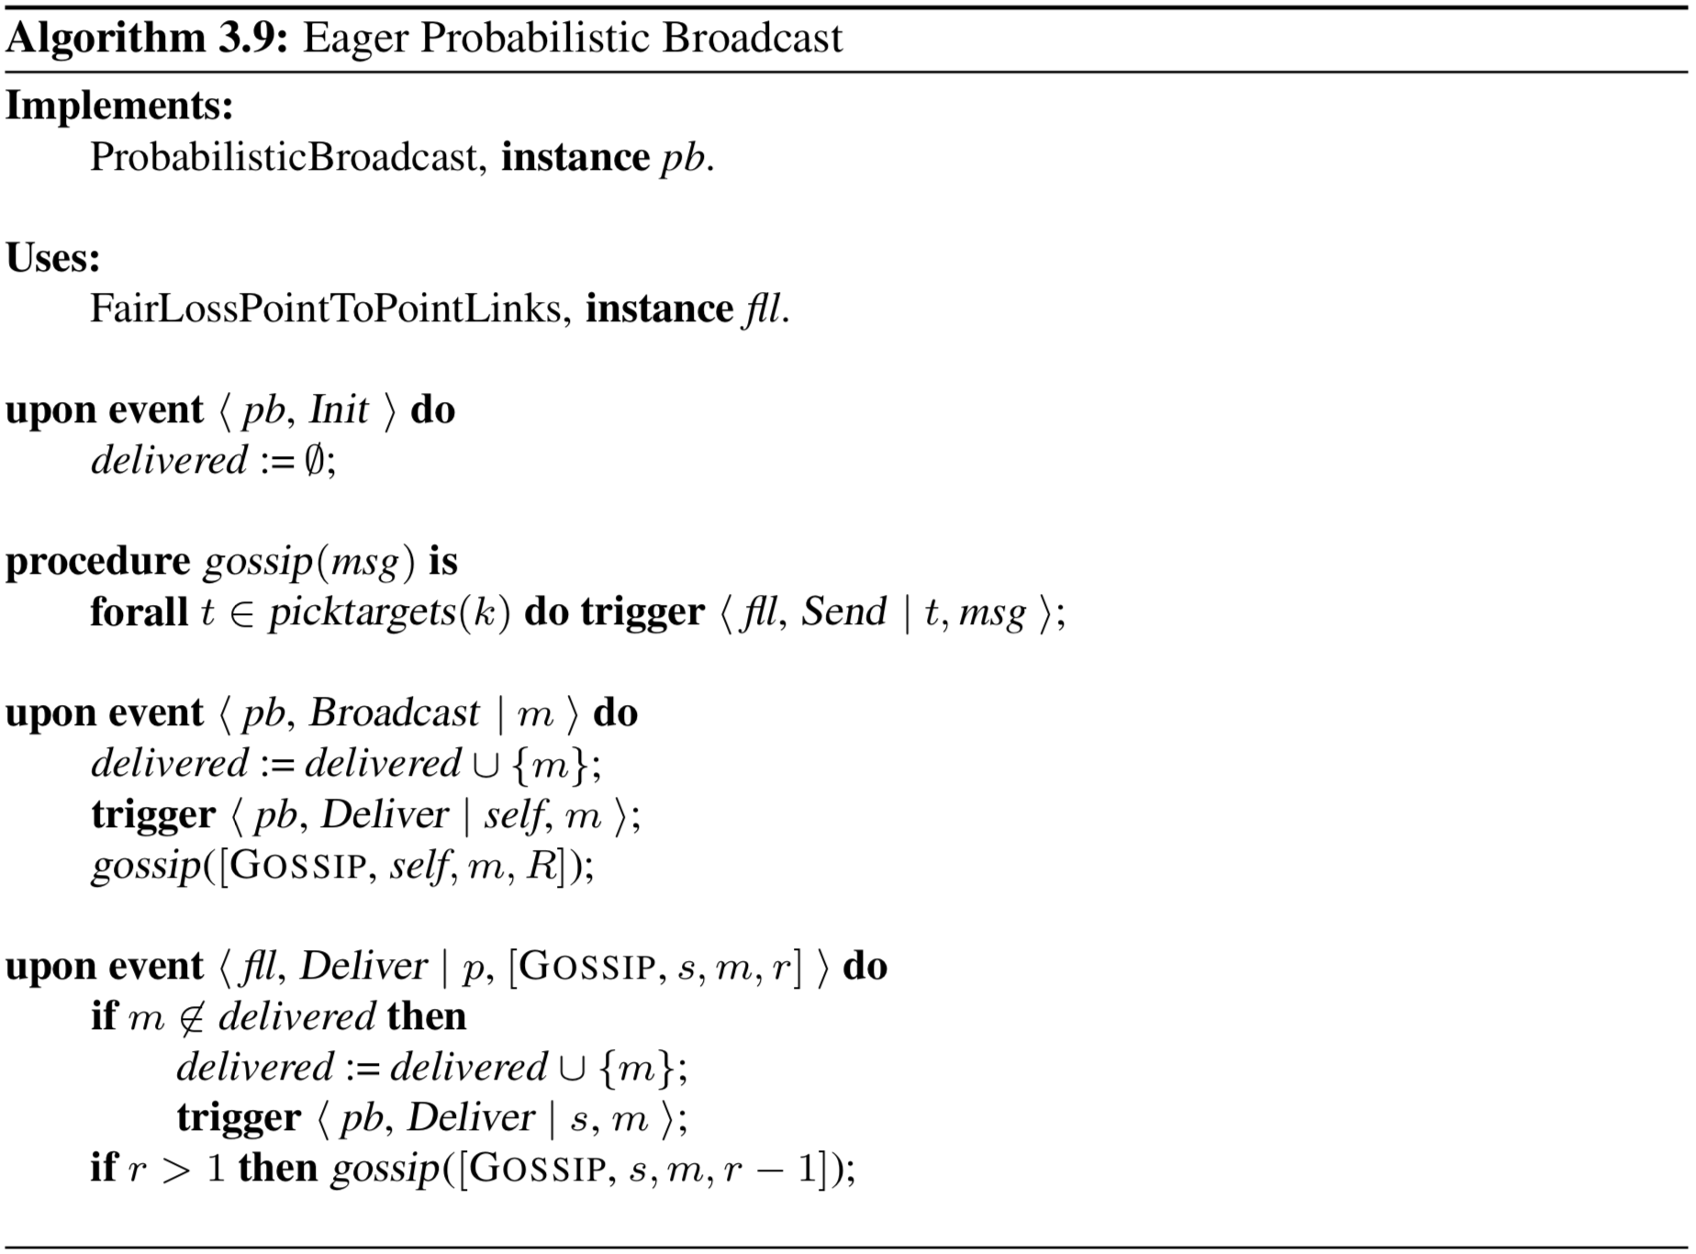
Notes:
PB1: Probabilistic validity: There is a positive value ε such that when a correct pro- cess broadcasts a message m, the probability that every correct process eventually deliversmisatleast1− ε.
PB2: No duplication: No message is delivered more than once.
PB3: No creation: If a process delivers a message m with sender s, then m was
previously broadcast by process s.
Performance: Every round involves one communication step. The algorithm may send O(N) messages in every round and O(N^{R}) messages in total, after running for R rounds (number of messages usually dominated by the last round)

Slide 72
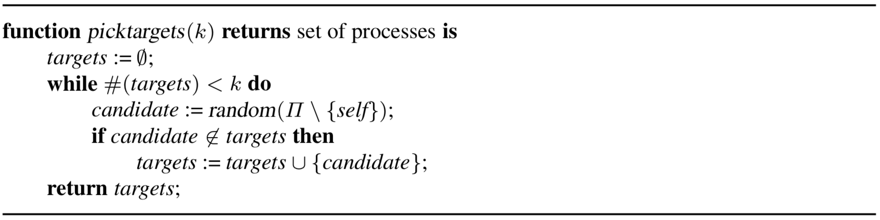
Notes:
PB1: Probabilistic validity: There is a positive value ε such that when a correct pro- cess broadcasts a message m, the probability that every correct process eventually deliversmisatleast1− ε.
PB2: No duplication: No message is delivered more than once.
PB3: No creation: If a process delivers a message m with sender s, then m was
previously broadcast by process s.
Performance: Every round involves one communication step. The algorithm may send O(N) messages in every round and O(N^{R}) messages in total, after running for R rounds (number of messages usually dominated by the last round)

Slide 73
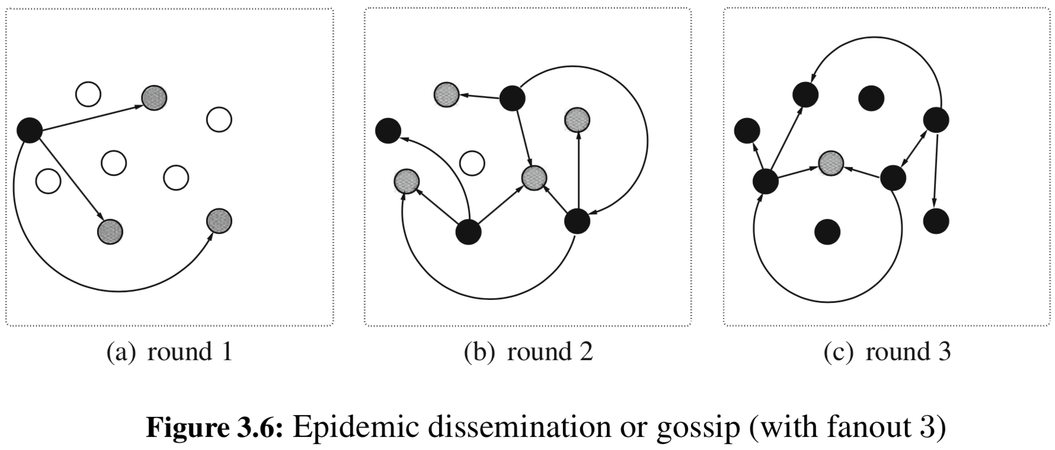
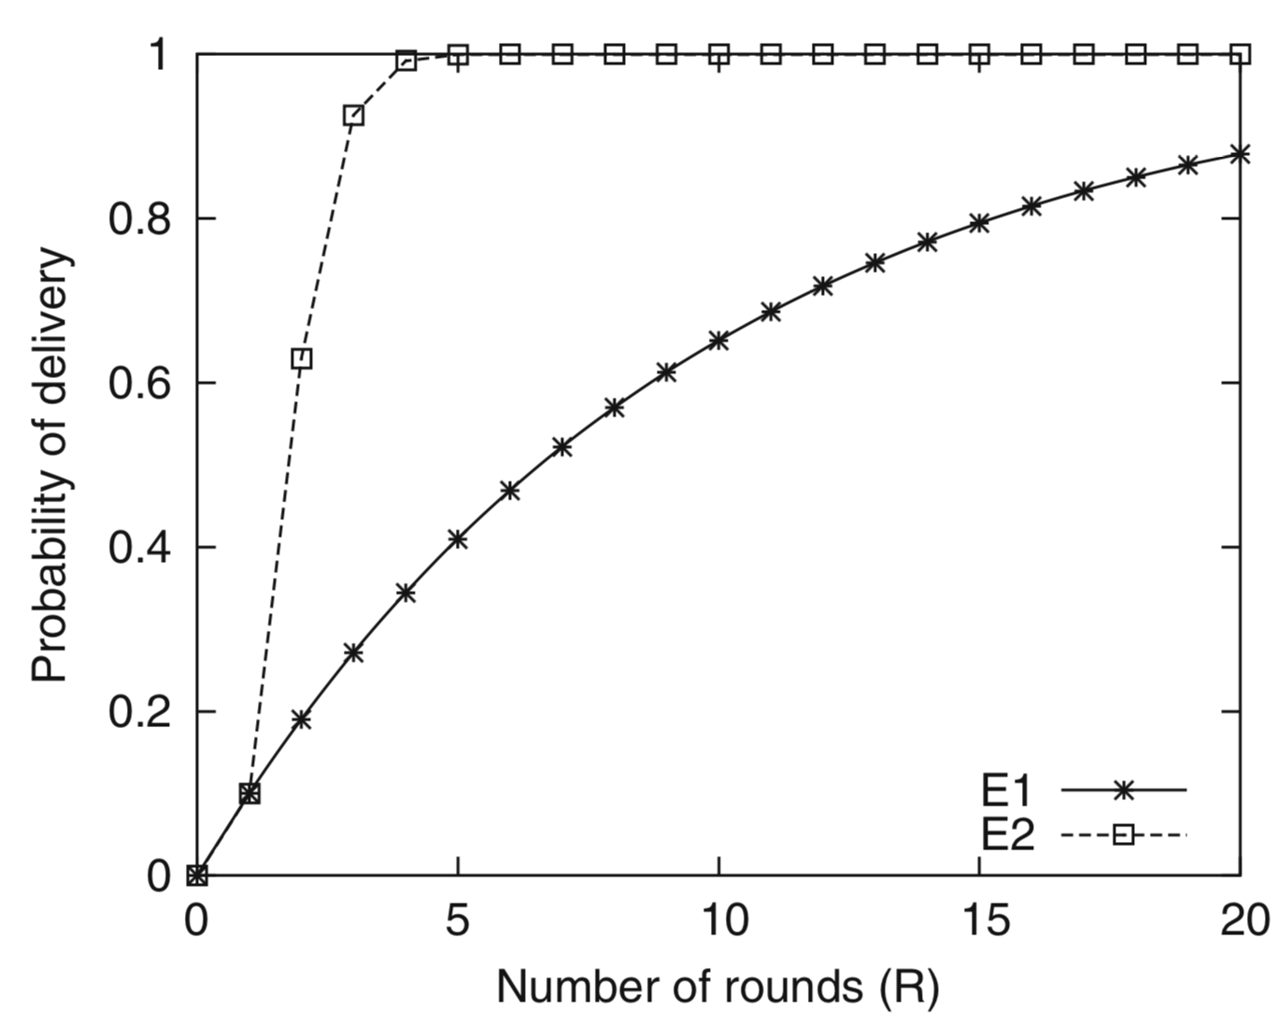
example

Slide 74
a different tact
Previous algorithm pushes messages to other processes
Can consume considerable resources and cause many redundant transmissions
Maybe we can ease up a bit
Have an initial phase where we use the push style
Once a decent number of processes infected, switch to something else, i.e., a pull mechanism
relies on the idea that senders have streams of messages with sequence numbers
when receiving a message, can look to see if the process has already delivered previous messages, i.e., look for gaps in sequence

Slide 75
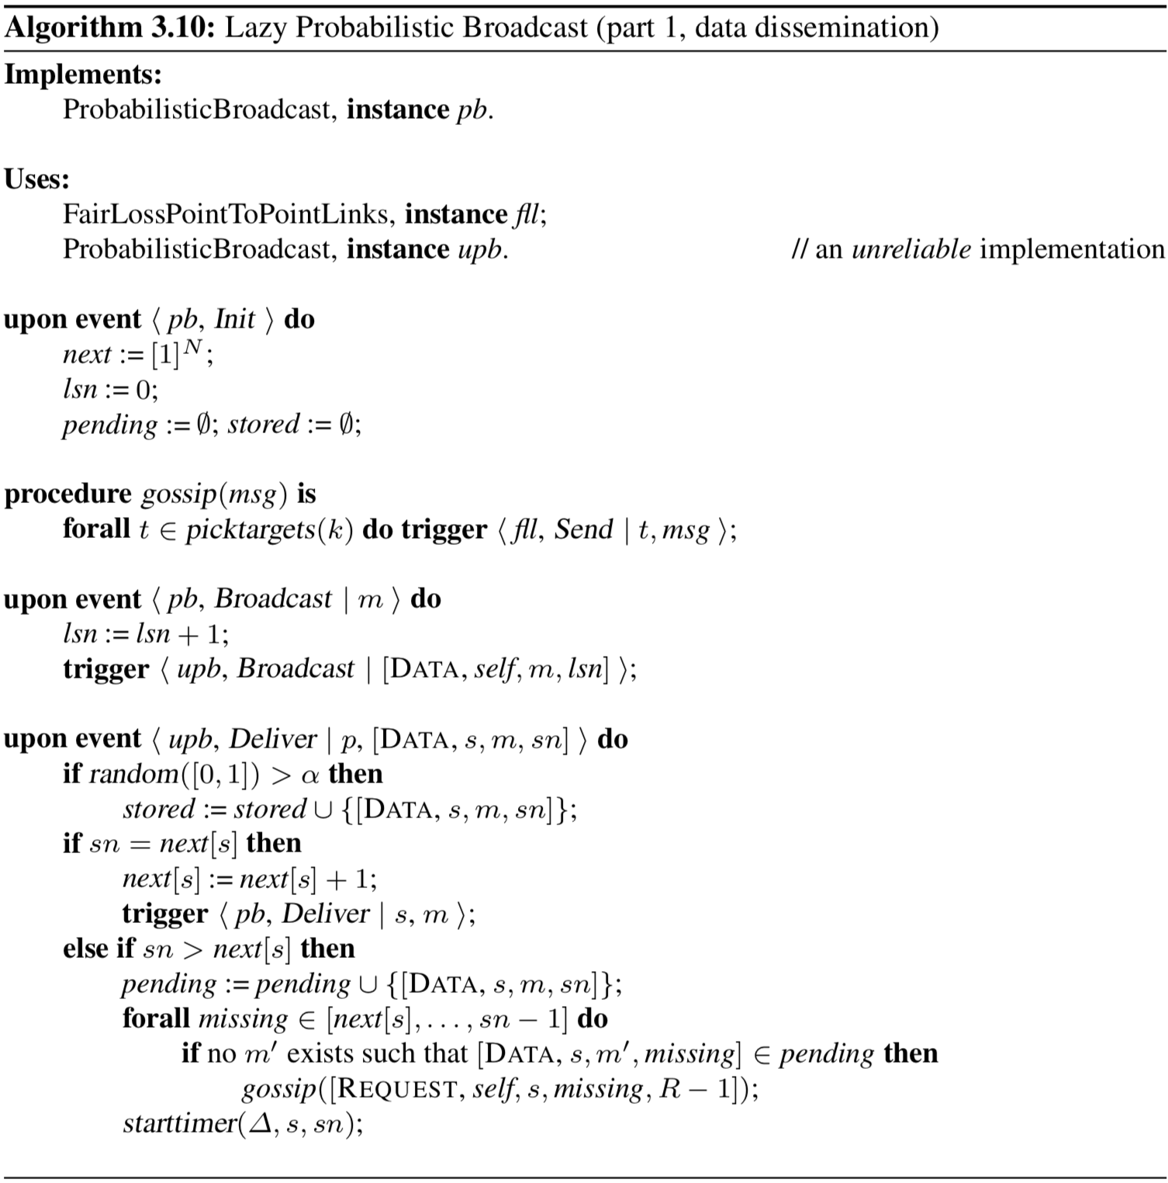
Notes:
Properties:
PB1: Probabilistic validity: There is a positive value ε such that when a correct pro- cess broadcasts a message m, the probability that every correct process eventually delivers m is at least 1− ε.
PB2: No duplication: No message is delivered more than once.
PB3: No creation: If a process delivers a message m with sender s, then m was
previously broadcast by process s.
Performance: (note, retransmitted messages are probably much smaller than data messages making this more resource effective than the eager algorithm)

Slide 76
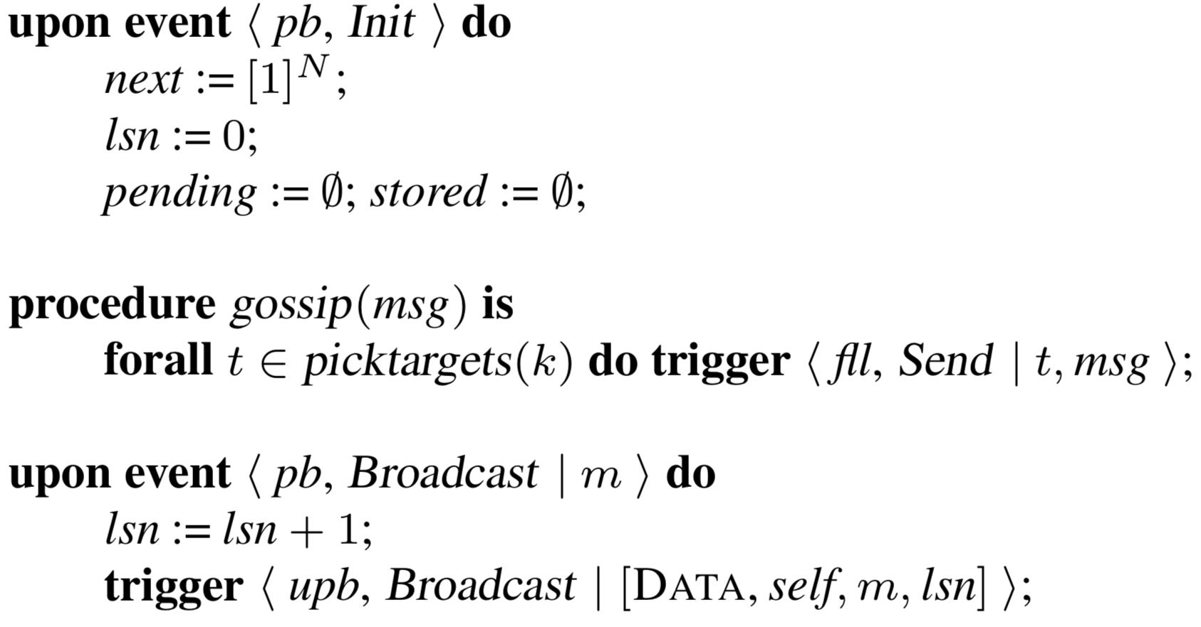
Notes:
Properties:
PB1: Probabilistic validity: There is a positive value ε such that when a correct pro- cess broadcasts a message m, the probability that every correct process eventually delivers m is at least 1− ε.
PB2: No duplication: No message is delivered more than once.
PB3: No creation: If a process delivers a message m with sender s, then m was
previously broadcast by process s.
Performance: (note, retransmitted messages are probably much smaller than data messages making this more resource effective than the eager algorithm)

Slide 77
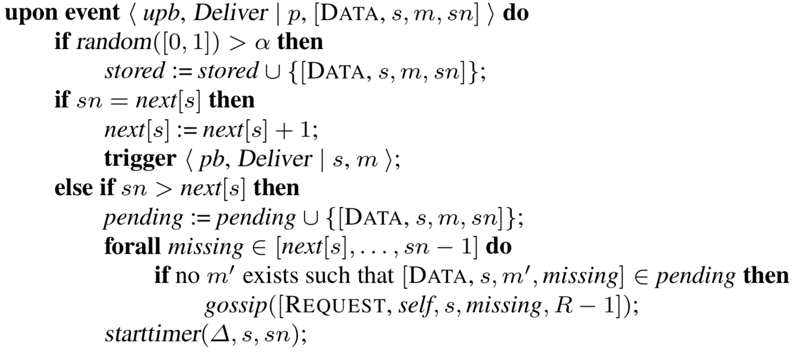
Notes:
Properties:
PB1: Probabilistic validity: There is a positive value ε such that when a correct pro- cess broadcasts a message m, the probability that every correct process eventually delivers m is at least 1− ε.
PB2: No duplication: No message is delivered more than once.
PB3: No creation: If a process delivers a message m with sender s, then m was
previously broadcast by process s.
Performance: (note, retransmitted messages are probably much smaller than data messages making this more resource effective than the eager algorithm)

Slide 78
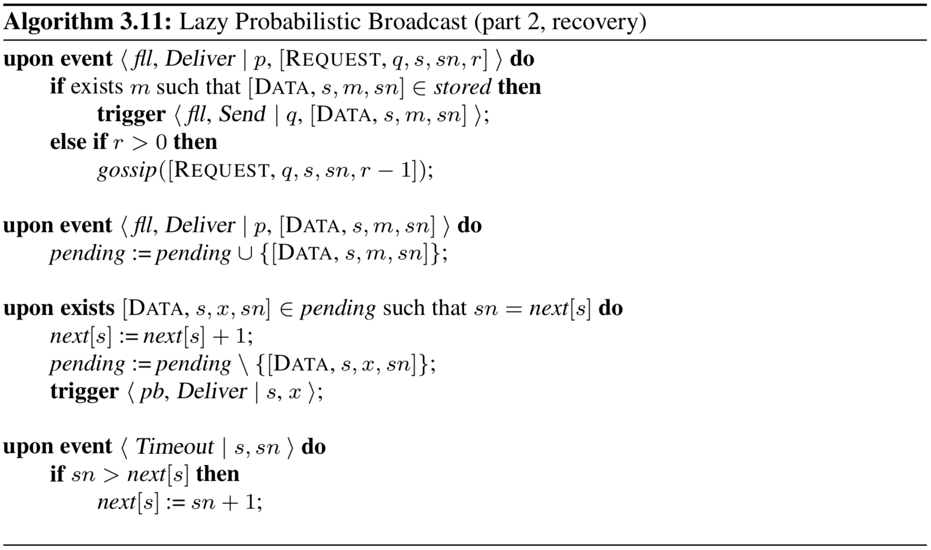
Notes:
Properties:
PB1: Probabilistic validity: There is a positive value ε such that when a correct pro- cess broadcasts a message m, the probability that every correct process eventually delivers m is at least 1− ε.
PB2: No duplication: No message is delivered more than once.
PB3: No creation: If a process delivers a message m with sender s, then m was
previously broadcast by process s.
Performance: (note, retransmitted messages are probably much smaller than data messages making this more resource effective than the eager algorithm)

Slide 79
Quick note on contamination and inconsistency
It is possible for a faulty node to “contaminate” a whole system, even with benign failures
For example
Consider 3 processes p, q and r and they all have a replicated variable x = 5 to start
p broadcasts message to increment x
q broadcasts message to double x
value of x should be 12
What if r delivers q’s message and not p’s?
Later, r might broadcast a change to some variable y based on its incorrect state of x, which propagates through the whole system
Notes:
There are methods to fix this which include sending information in a message that shows what each process has delivered in the past…

Slide 80
Transformations: A Modular approach
We want to make transformations of the previous algorithms
That is, given some broadcast primitive B, we want to transform it to a stronger broadcast (e.g., adding FIFO or Causal Order)
These transformations come from the paper “A Modular Approach…” and thus the notations are different

Slide 81

Reliable Broadcast
Notes:
Satisfies Validity, Agreement and Uniform Integrity
With TCP (FIFO links) this is actually a Causal Order Broadcast!
If only omission failures can occur, then this also satisfies Real-time Δ-Timeliness with Δ = (f+d)*δ

Slide 82
From one to another

Slide 83

From B to BA (Reliable to Atomic)
Notes:
If underlying Broadcast primitive has Local-time-delta-timeliness, then this achieves total order.
Preserves: Validity, Agreement, Integrity, FIFO and Causal Order (Causal by FIFO + Local Order)

Slide 84

Notes:
From reliable to fifo
Preserves validity, uniform fifo, agreement, uniform integrity, total order, uniform agreement, delta-timeliness (real and local)

Slide 85

Notes:
from fifo to causal non-blocking
Preserves most properties
Does NOT preserve delta-timeliness unless underlying FIFO broadcast satisfies uniform agreement
Also does NOT preserve uniform total order, only the non-uniform variant

Slide 86

Notes:
from fifo to causal blocking
this one DOES preserve uniform total order, uniform agreement and real-time-delta-timeliness as well as local-time-delta-timeliness (under certain assumptions explained in paper)

Slide 87

Notes:
If underlying FIFO broadcast satisfies uniform total order, then all processes get all the messages in the same order so if a message comes in out of order, the only possibility is that the process is NOT correct
Preserves uniform agreement and both versions of delta-timeliness

Slide 88

Notes:
This is a first optimization to reduce the size of messages and basically only broadcasts everything delivered since the last send operation

Slide 89

Notes:
This optimization tries to reduce the size of the matrix that is stored on each machine. If the algorithm ran for a very long time, these buffers would grow unbounded…

Slide 90
byzantine broadcast
Byzantine processes may deviate arbitrarily from the instructions that an algorithm assigns to them
could be deliberately trying to prevent algorithm from achieving its goals
maybe by sending different messages to different processes to violate agreement
could be accidental (bad code, etc.)
For fail-arbitrary model, cryptography is relied upon
usually through authenticated perfect links
definitely NOT enough though

Slide 91
considerations for byzantine broadcast
Regardless of when a process exhibits any bad behavior, it is always considered faulty in the whole run
A faulty sender is not bound to properly tag the application messages and it may even pretend to have broadcast any message
thus need to define agreement a bit differently
We consider a single instance of broadcast
each instance only serves to reach agreement on a single delivered message
use multiple instances, one for each message, for whole algorithm

Slide 92

Notes:
requires that the number of faulty processes satisfies f < N/3
Which are safety and which are liveness? validity is liveness, rest are safety

Slide 93

Notes:
requires N > 3f
Properties:
BCB1: Validity: If a correct process p broadcasts a message m, then every correct process eventually delivers m.
BCB2: No duplication: Every correct process delivers at most one message. BCB3: Integrity: If some correct process delivers a message m with sender p and
process p is correct, then m was previously broadcast by p.
BCB4: Consistency: If some correct process delivers a message m and another
correct process delivers a message m′, then m = m′.
Performance: requires two communication steps, each using O(N²) messages

Slide 94


Notes:
requires N > 3f
Properties:
BCB1: Validity: If a correct process p broadcasts a message m, then every correct process eventually delivers m.
BCB2: No duplication: Every correct process delivers at most one message. BCB3: Integrity: If some correct process delivers a message m with sender p and
process p is correct, then m was previously broadcast by p.
BCB4: Consistency: If some correct process delivers a message m and another
correct process delivers a message m′, then m = m′.
Performance: requires two communication steps, each using O(N²) messages

Slide 95

Notes:
requires N > 3f
Properties:
BCB1: Validity: If a correct process p broadcasts a message m, then every correct process eventually delivers m.
BCB2: No duplication: Every correct process delivers at most one message. BCB3: Integrity: If some correct process delivers a message m with sender p and
process p is correct, then m was previously broadcast by p.
BCB4: Consistency: If some correct process delivers a message m and another
correct process delivers a message m′, then m = m′.
Performance: requires two communication steps, each using O(N²) messages

Slide 96

Notes:
requires N > 3f
Properties:
BCB1: Validity: If a correct process p broadcasts a message m, then every correct process eventually delivers m.
BCB2: No duplication: Every correct process delivers at most one message. BCB3: Integrity: If some correct process delivers a message m with sender p and
process p is correct, then m was previously broadcast by p.
BCB4: Consistency: If some correct process delivers a message m and another
correct process delivers a message m′, then m = m′.
Performance: requires two communication steps, each using O(N²) messages

Slide 97

example
$$m^{′}≠m$$
Notes:
p echoes a message m’ != m to r while echoing m to q and s
r will NOT deliver m’ because it does not get enough echoes for m’

Slide 98

Notes:
Properties:
BCB1: Validity: If a correct process p broadcasts a message m, then every correct process eventually delivers m.
BCB2: No duplication: Every correct process delivers at most one message. BCB3: Integrity: If some correct process delivers a message m with sender p and
process p is correct, then m was previously broadcast by p.
BCB4: Consistency: If some correct process delivers a message m and another
correct process delivers a message m′, then m = m′.
Performance: 3 communication steps, each sending O(N) messages

Slide 99


Notes:
Properties:
BCB1: Validity: If a correct process p broadcasts a message m, then every correct process eventually delivers m.
BCB2: No duplication: Every correct process delivers at most one message. BCB3: Integrity: If some correct process delivers a message m with sender p and
process p is correct, then m was previously broadcast by p.
BCB4: Consistency: If some correct process delivers a message m and another
correct process delivers a message m′, then m = m′.
Performance: 3 communication steps, each sending O(N) messages

Slide 100


Notes:
Properties:
BCB1: Validity: If a correct process p broadcasts a message m, then every correct process eventually delivers m.
BCB2: No duplication: Every correct process delivers at most one message. BCB3: Integrity: If some correct process delivers a message m with sender p and
process p is correct, then m was previously broadcast by p.
BCB4: Consistency: If some correct process delivers a message m and another
correct process delivers a message m′, then m = m′.
Performance: 3 communication steps, each sending O(N) messages

Slide 101

Notes:
Properties:
BCB1: Validity: If a correct process p broadcasts a message m, then every correct process eventually delivers m.
BCB2: No duplication: Every correct process delivers at most one message. BCB3: Integrity: If some correct process delivers a message m with sender p and
process p is correct, then m was previously broadcast by p.
BCB4: Consistency: If some correct process delivers a message m and another
correct process delivers a message m′, then m = m′.
Performance: 3 communication steps, each sending O(N) messages

Slide 102

Example

Slide 103
byzantine reliable broadcast
Previous algorithms do not ensure “agreement”
a correct process delivers a message if and only if every other correct process delivers a message
Requires that N > 3f

Slide 104

byzantine reliable broadcast

Slide 105

byzantine reliable broadcast
Notes:
Consistency + Totality = Agreement

Slide 106

Notes:
Properties:
BRB1: Validity: If a correct process p broadcasts a message m, then every correct process eventually delivers m.
BRB2: No duplication: Every correct process delivers at most one message. BRB3: Integrity: If some correct process delivers a message m with sender p and
process p is correct, then m was previously broadcast by p.
BRB4: Consistency: If some correct process delivers a message m and another
correct process delivers a message m′, then m = m′.
BRB5: Totality: If some message is delivered by any correct process, every correct process eventually delivers a message.
Performance: 3 total communication steps, first is O(N) from sender to all other processes, the remaining 2 communication steps are all-to-all, O(N²) messages

Slide 107


Notes:
Properties:
BRB1: Validity: If a correct process p broadcasts a message m, then every correct process eventually delivers m.
BRB2: No duplication: Every correct process delivers at most one message. BRB3: Integrity: If some correct process delivers a message m with sender p and
process p is correct, then m was previously broadcast by p.
BRB4: Consistency: If some correct process delivers a message m and another
correct process delivers a message m′, then m = m′.
BRB5: Totality: If some message is delivered by any correct process, every correct process eventually delivers a message.
Performance: 3 total communication steps, first is O(N) from sender to all other processes, the remaining 2 communication steps are all-to-all, O(N²) messages

Slide 108

Notes:
Properties:
BRB1: Validity: If a correct process p broadcasts a message m, then every correct process eventually delivers m.
BRB2: No duplication: Every correct process delivers at most one message. BRB3: Integrity: If some correct process delivers a message m with sender p and
process p is correct, then m was previously broadcast by p.
BRB4: Consistency: If some correct process delivers a message m and another
correct process delivers a message m′, then m = m′.
BRB5: Totality: If some message is delivered by any correct process, every correct process eventually delivers a message.
Performance: 3 total communication steps, first is O(N) from sender to all other processes, the remaining 2 communication steps are all-to-all, O(N²) messages

Slide 109

Notes:
Properties:
BRB1: Validity: If a correct process p broadcasts a message m, then every correct process eventually delivers m.
BRB2: No duplication: Every correct process delivers at most one message. BRB3: Integrity: If some correct process delivers a message m with sender p and
process p is correct, then m was previously broadcast by p.
BRB4: Consistency: If some correct process delivers a message m and another
correct process delivers a message m′, then m = m′.
BRB5: Totality: If some message is delivered by any correct process, every correct process eventually delivers a message.
Performance: 3 total communication steps, first is O(N) from sender to all other processes, the remaining 2 communication steps are all-to-all, O(N²) messages

Slide 110

Notes:
Properties:
BRB1: Validity: If a correct process p broadcasts a message m, then every correct process eventually delivers m.
BRB2: No duplication: Every correct process delivers at most one message. BRB3: Integrity: If some correct process delivers a message m with sender p and
process p is correct, then m was previously broadcast by p.
BRB4: Consistency: If some correct process delivers a message m and another
correct process delivers a message m′, then m = m′.
BRB5: Totality: If some message is delivered by any correct process, every correct process eventually delivers a message.
Performance: 3 total communication steps, first is O(N) from sender to all other processes, the remaining 2 communication steps are all-to-all, O(N²) messages

Slide 111

example

Slide 112
byzantine broadcast channels
Algorithms for fail-arbitrary processes thus far have only allowed one sender, one message
not exactly the most useful compared to Reliable Broadcast
Byzantine Broadcast Channels are the Byzantine equivalent to Reliable Broadcast
allows for multiple senders and arbitrary number of messages
uses labels that must be unique for each message-sender pair

Slide 113


Slide 114

Notes:
instance bcb.1.n[1], bcb.2.n[2], bcb.3.n[3], … bcb.N.n[N]
Properties:
BCCH1: Validity: If a correct process p broadcasts a message m, then every correct process eventually delivers m.
BCCH2: No duplication: For every process p and label l, every correct process delivers at most one message with label l and sender p.
BCCH3: Integrity: If some correct process delivers a message m with sender p and process p is correct, then m was previously broadcast by p.
BCCH4: Consistency: If some correct process delivers a message m with label l and sender s, and another correct process delivers a message m′ with label l and sender s, then m = m′.

Slide 115


byzantine reliable channel

Slide 116

byzantine reliable channel

Slide 117
Multicast
Broadcast assumes it is targeted to all nodes in the system
Multicast allows a process to join multiple (possibly overlapping) groups
Messages are then addressed to a group
If a process p is in a group g and a message m is sent to g, then p should receive it.
Group membership problem… not so concerned with

Slide 118

Reliable Multicast
Notes:
If group(m) is the set of all processes, this is Reliable Broadcast
The specification does NOT require that a sender of message m be a member of the group(m)

Slide 119


FIFO Multicast
Notes:
If a process belong to different groups, and a sender send to those different groups, Global FIFO keeps all the messages across groups in order, but Local FIFO does not care about such a case.

Slide 120


Causal Multicast
Notes:
same thing as FIFO for global vs. local

Slide 121
Atomic Multicast
Notes:
m < m’ iff any correct process delivers m and m’, in that order

Slide 122

Timed Multicast

Slide 123
And then there was…
Aggregated multicast
Incentive opportunity:
Gregory Aaron Wilkin, K. R. Jayaram, Patrick Eugster, Ankur Khetrapal: FAIDECS: Fair Decentralized Event Correlation. Middleware 2011
Gregory Aaron Wilkin, Patrick Eugster: Multicasting in the presence of aggregated deliveries. J. Parallel Distrib. Comput. (2013)
Gregory Aaron Wilkin, Patrick Eugster, K. R. Jayaram: Decentralized Fault-Tolerant Event Correlation. ACM Trans. Internet Techn. (2014)

Slide 124
problems for chapter test
Best-effort Broadcast — specification AND algorithm
Reliable Broadcast — specification AND algorithms (includes Lazy Reliable Broadcast and Eager Reliable Broadcast)
What is Uniform Agreement?
What is Probabilistic Validity?
FIFO Reliable Broadcast — specification AND algorithm
What are the three relations that determine if one message has caused another?
What is the Causal Delivery property?
What is the difference between Byzantine Consistent Broadcast and Byzantine Reliable Broadcast?
Exercises: 3.1?; 3.2; 3.3 (1-3); 3.4; 3.5; 3.6?; 3.7?; 3.8??; 3.10; 3.11; 3.14; 3.15;
Notes:
will need to have memorized 6 different algorithms for the problems given

